Slide 1


BHS Administration
MHMIS Unit
CCBH Access Request

Slide 2


Rejected ARF’s
20% of ARF’s are rejected.
Wastes time/Delays Processing
  Each one needs vetting by MIS staff
  Processed by MIS staff
  Returned and then you have more work to do
  Resubmit
  Needs Vetting and Processing again
Notes:
20% of ARFs get rejected.
This is very time consuming for all of us.
It delays getting staff into trainings.
It slows down productivity in your program.
An ARF is faxed to our efax.
Then it is vetted by our Admin staff, who do some QA, checking NPI and taxonomy numbers, making sure SOP and ESA are attached, all fields completed.
After vetting, it is brought to my desk, and I process the ARF’s as they come in.
Sometimes I may be at a meeting, or working on something else, and cannot get to them immediately.
If I find something wrong with the ARF, I must reject it, and send a notification to you.
It can be a couple of minutes to several days before I get it back again. In the meantime, you may need to find staff to re-sign the ARF and forms.
Then it gets vetted again, and brought to my desk.
If it still is not right, it goes back to you, and the cycle continues.

Slide 3
Most Common Reasons for Rejections
Incomplete fields
Not typed
Signatures missing
Using an outdated form
Credentialing information incorrect
  NPI
  Taxonomy
  License/Registration number
Notes:
There are many reasons an ARF can get rejected, but here are some common ones:
Incomplete fields: Please make sure to fill the form in completely.
Typing is required. After today, all ARFs will be rejected if not types. This especially important for SSN numbers
Credentialing information:
Every clinician must have an NPI and taxonomy.
Taxonomies must match the credential
If Licensed or Registered, we must have that correct number
Make sure to get all signatures on all the forms.

Slide 4
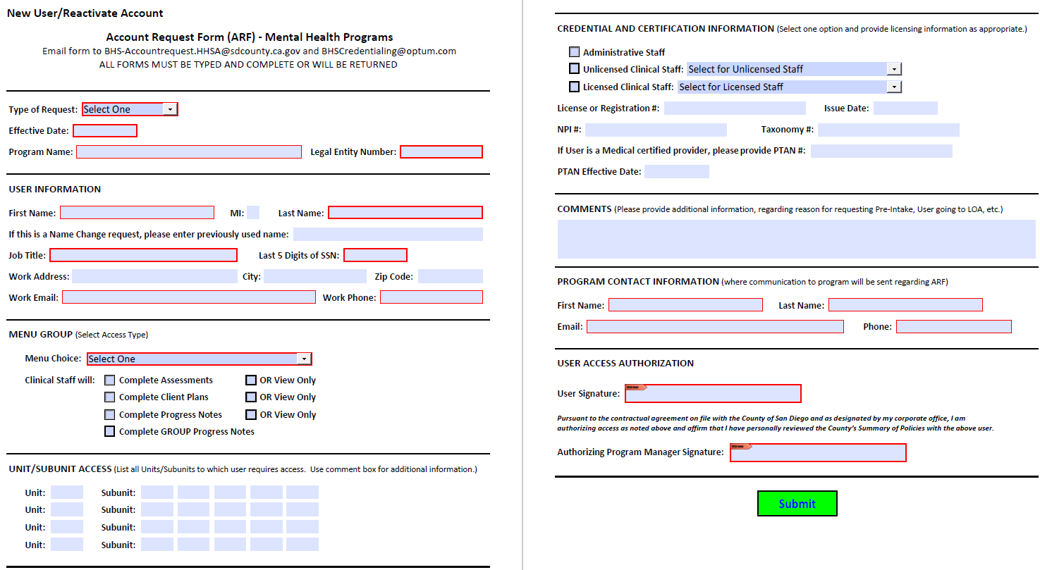
Notes:
A new look to the ARF. Notice the Required fields, the Digital Signatures and the Submit Button.

Slide 5
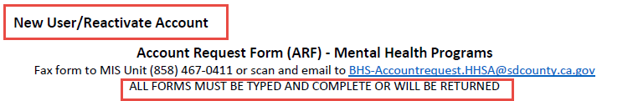
New User/Reactivate ARF
New to your legal entity
Name change
Reactivating a dormant account for
your legal entity
Notes:
The top of the ARF describes the purpose. New User/Reactivate Account:
What is a New User?
New to your legal entity. If user has an account for a different legal entity, this staff is still a New User for yours.
If user is active, but has changed names, it is considered a New User
What is Reactivate Account?
If user has been active in the past under your legal entity, you are requesting the account to be reactivated, and this form must be used.
Even if it is just a short time, a Leave of Absence, or a long time away from your legal entity.

Slide 6

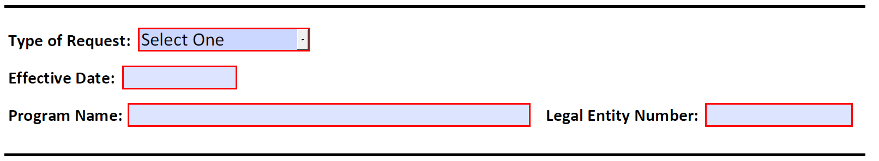
New User/Reacativate ARF
Select from the drop down menu
Enter the Effective date: Date user will begin providing claimable services
Program Name
Know your Legal Entity Number
Notes:
New User (this includes if a user is new to your legal entity) If they have an ID from somewhere else, they are still a “New User”
Name Change: Did the user get married, or change their name in any other way? This is for active users who have name changes, not former names for a new user.

Slide 7
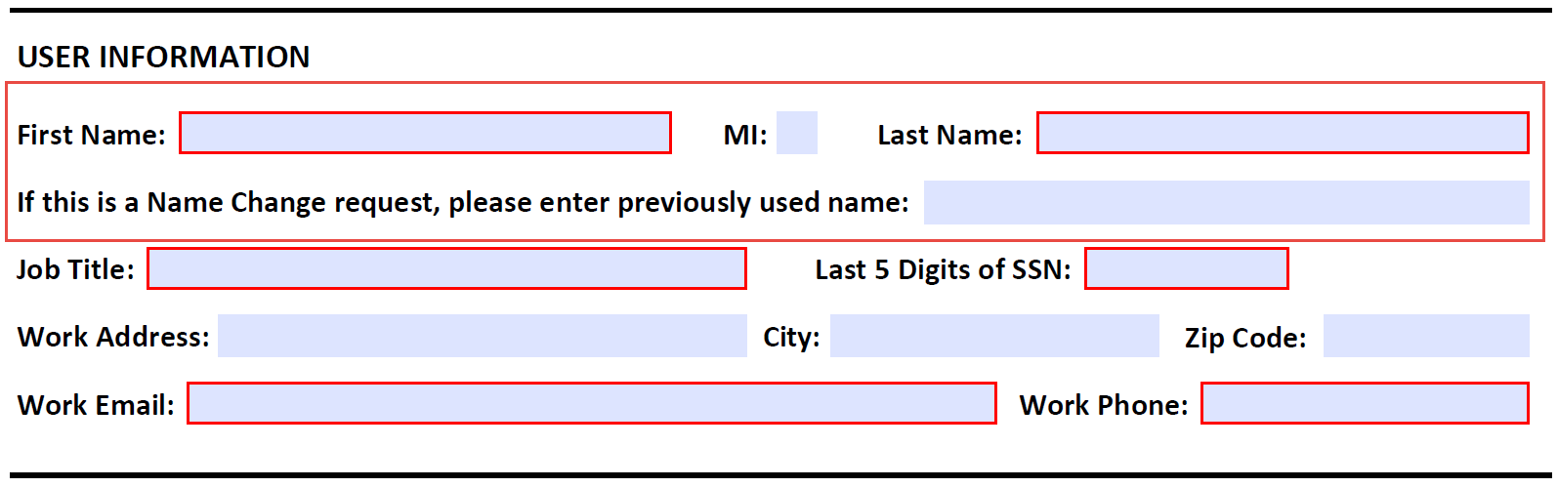
New User/Reacativate ARF
Legal Name
Name change (active staff)
Notes:
Use the legal name: For clinical staff, the name must match what is on the licensing board and the NPI registry.
Name Change is ONLY for active or returning users who have changed their name by marriage, divorce, etc. Do not use this for new users.

Slide 8
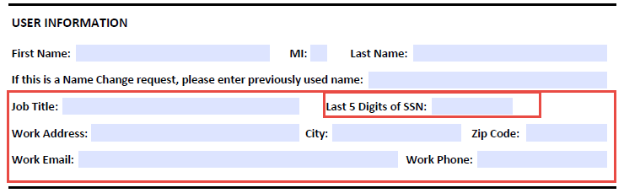
New User/Reactivate ARF
Job Title
Last 5 digits of SSN
Work email: must be an
organizational email
Notes:
Job Title: What is the job title for this staff?
SSN: Must be the Last 5 digits of the SSN for identification purposes
Enter the work address and phone number
Work email: must be an organizational email – no yahoo, gmail accounts

Slide 9
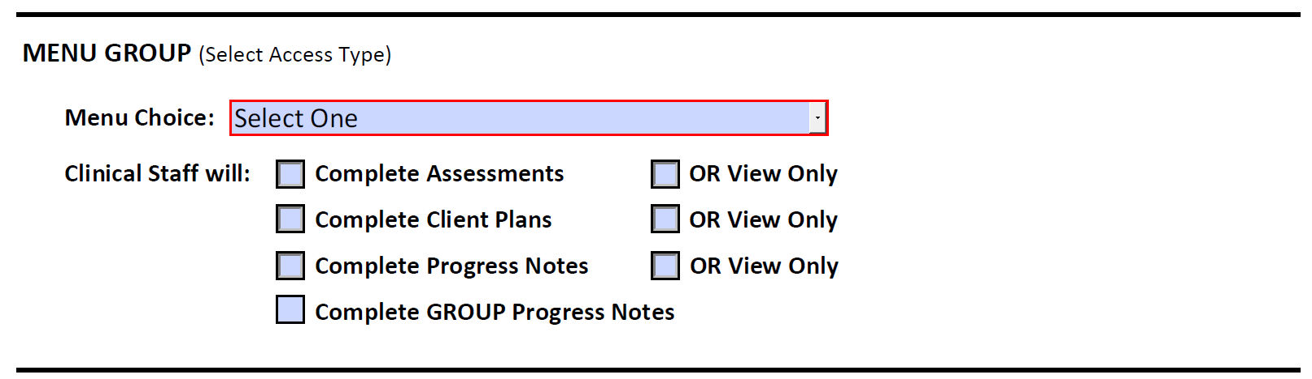
New User/Reactivate ARF
Select menu
Select intended use for Clinical Staff

Slide 10
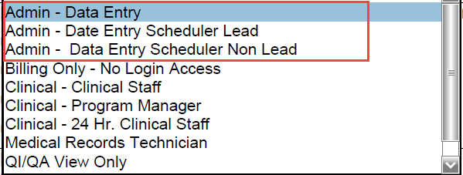
New User/Reactivate ARF
Admin – Data Entry
  Most Admin staff
  Can Add Clients/Open and Close Assignments
Admin – Data Entry Scheduler Lead
  Can set up staff schedules and Scheduler for all
Admin – Data Entry Scheduler Non-Lead
  Back Up for Scheduler. Cannot set up staff schedules
Notes:
Admin – Data Entry: most Admin staff
Scheduler Lead – for Admins who will be setting up Scheduler
Non lead – for Admins who only back up the schedules

Slide 11
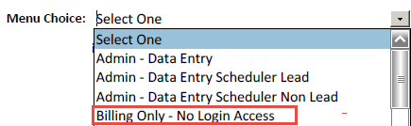
New User/Reactivate ARF Billing Only Menu
For identified staff only
  MD/RN at the Psych Hospital
  Some on-call staff at START programs
Staff cannot log in and cannot complete clinical information in CCBH
Notes:
Billing Only – this is used only by certain staff approved by MIS and QM

Slide 12
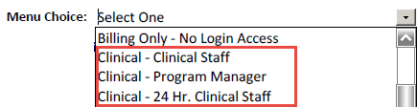
New User/Reactivate ARF
Clinical Menus
Clinical – Clinical Staff
  Most common
  For any staff who provide services
Clinical – Program Manager
  Only one PM menu per program
  Some exceptions, on approval
Clinical – 24 Hr. Clinical Staff
  For START/ESU/ PERT/IHOT
Notes:
Clinical – Clinical Staff: most common for all clinicians
Clinical PM: only one PM menu per program – there are some exceptions, however, approval granted by MIS
Clinical – 24 hour programs: Used for PERT, START, IHOT programs

Slide 13
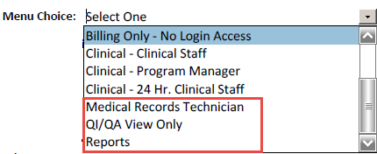
New User/Reactivate ARF
Other Menus
Medical Records Technician
  Must meet criteria and be approved
QI/QA – View Only
  For QA Staff at programs or legal entity level
  Must meet criteria and be approved
Reports: for County Analyst staff, Administrators for Legal Entities
  No data entered
Notes:
MRT: Special qualifications are necessary for this. Used by Admin staff who also must handle records.
QI/QA View Only: for QA departments of legal entities, or large programs who have staff to review clinical data without entering
If you are requesting an MRT or QI/QA menu, please contact MIS for an addendum to the ARF that must be signed by the Program Manager and submitted.
Reports: Used mainly by County analysts and some legal entity administrators
If there are other special menus requested, please note in the Comments section.

Slide 14
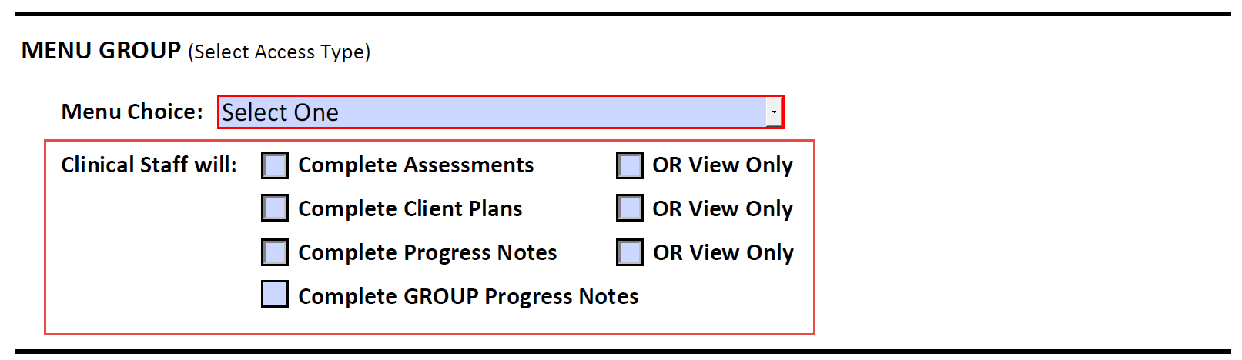
New User/Reactivate ARF
Clinical Menus
  Choose one from each line
  Complete or View Assessments, Client Plans and Progress Notes
Clinician completing GROUP Progress Notes
  Only if the clinician will complete Group PNs
Notes:
For Clinical Staff
Answer:
Will they complete assessments, yes or no
Will they complete client plans, yes or no
Will they complete progress notes yes or no.
If clinician will write Group Progress Notes, please check this box

Slide 15
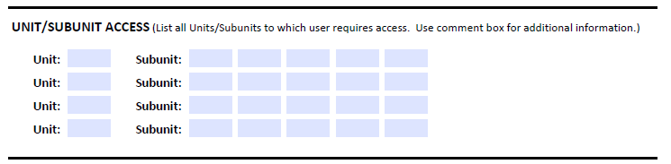
New User/Reactivate ARF
Enter all Units/SubUnits needed for User
  If more needed, add in Comments Box or on a separate sheet
Notes:
Enter the Units and SubUnits that the user will need for the work they do.
If there are Units/SubUnits no longer needed, make a comment in Comments section

Slide 16

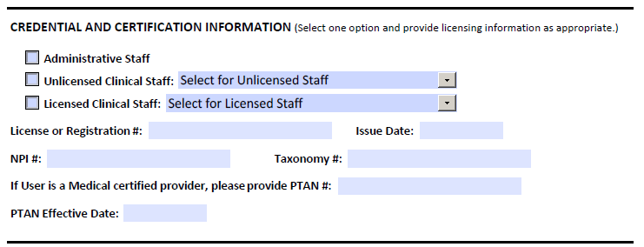
New User/Reactivate ARF
Everyone has a credential!
Notes:
Section 6: Credentials
Every staff must have a credential. Only one credential per user.
This does not mean they have gone to college. The work credential is a CCBH term, meaning that the user has what they need for the menu they are requesting.

Slide 17
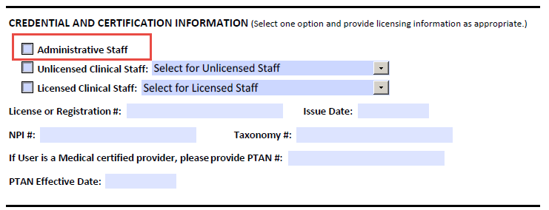

New User/Reactivate ARF
Admin Staff
Titled Admin Staff/Office Assistants, etc.
Some staff in Legal Entities central offices
County Analyst Staff
Any staff who only needs to see Reports
Notes:
For Admin staff, some staff in legal entities, County analyst staff, any staff who only needs to see reports.
Check the box.
Do not make that a default, because if you have the box checked and then need to complete for a clinician, we will return the ARF.

Slide 18
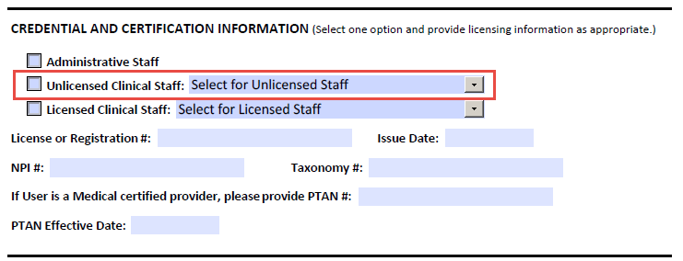

New User/Reactivate ARF
Unlicensed Clinical Staff
Unlicensed Clinical Staff – anyone without a license
Notes:
For an Unlicensed staff, select the box. This will be for any staff who does not have a license.

Slide 19
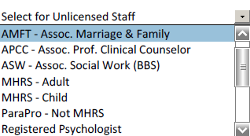
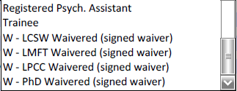
New User/Reactivate ARF
Unlicensed Clinical Staff
Interns with a registration number with the BBS
Trainees in school
Para Pros
MHRS
Registered Psychologists/Techs
Waivered clinicians (must include the Waiver)
Notes:
It includes interns, trainees, MHRS staff, ParaPros, and waivered staff. If it is truly a waivered staff, you must include the Waiver paperwork signed by the County.
AMFT’s, ASW’s, APCC’s are not Waivered.
MHRS staff are for Adult or Child programs.
There are requirements for education/experience for MHRS and ParaPros. Your program manager should refer to the OPOH for these requirements in order to select the correct credential for staff.
MHRS in adult programs may complete assessments and client plans, with co-signatures.
MHRS in child programs are not allowed to complete assessments. Some do complete Client Plans, and they will complete progress notes.
Para Pros in all programs only write Progress Notes.

Slide 20
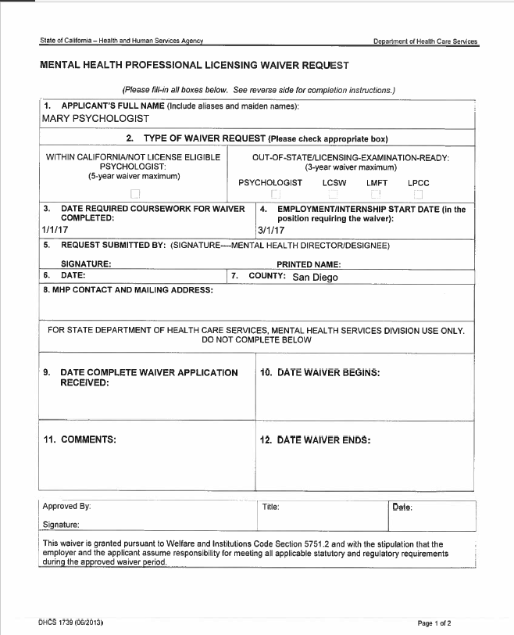
Notes:
This is a Waiver. It must be signed by QM and a copy must accompany the ARF.

Slide 21
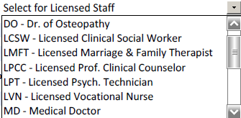

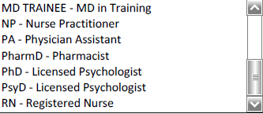
New User/Reactivate ARF Licensed Clinical Staff
Must be licensed to treat in California
Notes:
Licensed staff are Doctors, Osteopaths, LCSW’s, LMFT’s, LPCC’s, Nurses, Nurse Practitioners, Psychologists, Pharmacologists, Physician Assistants.
All must have a license.

Slide 22

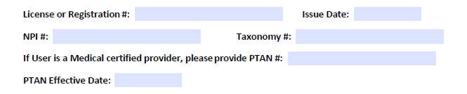
New User/Reactivate ARF
Department of Consumer Affairs - DCA
NPPES – NPI Registry for NPI # and Taxonomy
PTAN – for MD’s/LCSW/RN’s who bill Medi Care
Notes:
Enter the License or Registration number. A registration number is used for AMFT, ASW and APCC who are interns, registered with the BBS.
(Next)
All clinicians must have an NPI and Taxonomy. Anyone who provides services. The numbers must match what is on the NPI Registry. Taxonomies can be tricky. Make sure the user has the correct taxonomy for their credential. If an ASW gets a license, the taxonomy must be changed.
(Next)
If the user will be billing Medicare (MD’s, NP’s and LCSW’s) enter the PTAN and Effective date here

Slide 23

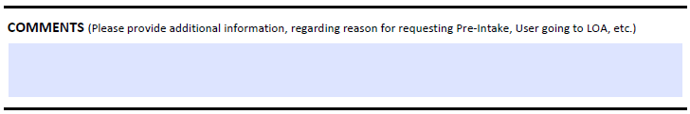
New User/Reactivate ARF
Use for telling MIS any pertinent
information
  Need for Pre-Intake
  Previous name ID
Notes:
Section 7: Comments
This is an important part of the ARF.
Tell us anything we need to know regarding the account request.
User needs Pre-Intake
Admin staff who need Client Attachments
If it is a name change, the ID under the old name
Anything that will help us expedite your ARF

Slide 24
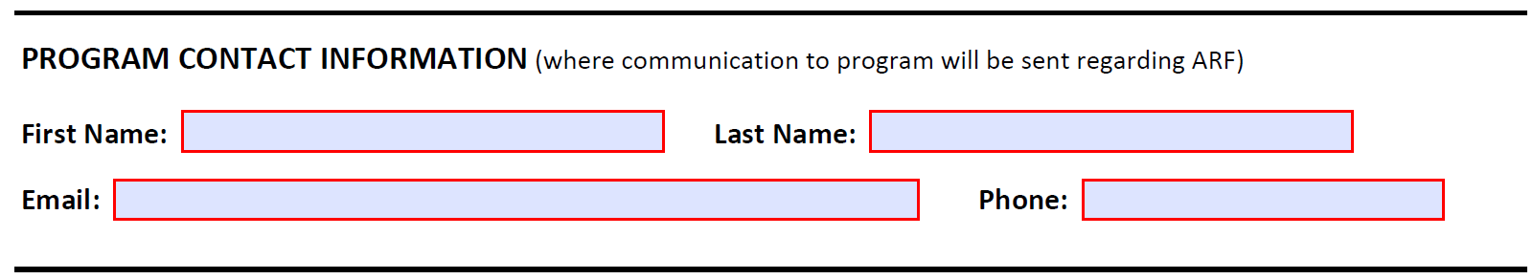
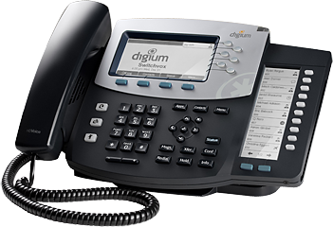
New User/Reactivate ARF
Program Contact
Staff we can contact for information or to
report on processing the ARF
Make sure to enter correct email and phone
number
Not the clinician requesting access
  Should be Admin or Program Manager
Notes:
Section 8: Program Content
This is for staff that we can contact regarding the ARF. Usually it will be you. Make sure to add your email and phone number.
Please do not put the User name here.

Slide 25

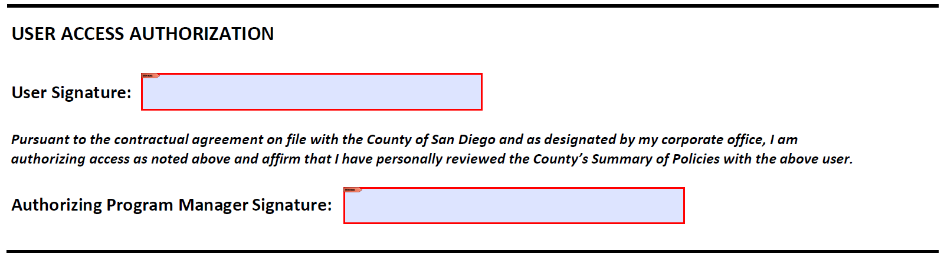
New User/Reactivate ARF Authorization
Digital Signatures
Notes:
Section 9
The User must sign this portion. Type in the name and date signed.
An original handwritten signature must be used. We cannot accept a typed signature that is of a font that looks handwritten.

Slide 26
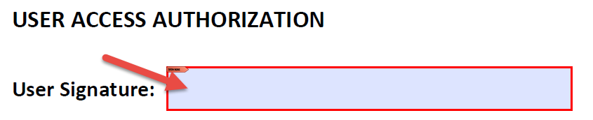
New User/Reactivate ARF Authorization
Send to the User
User adds digital signature
HOW TO CREATE
Click in the field

Slide 27

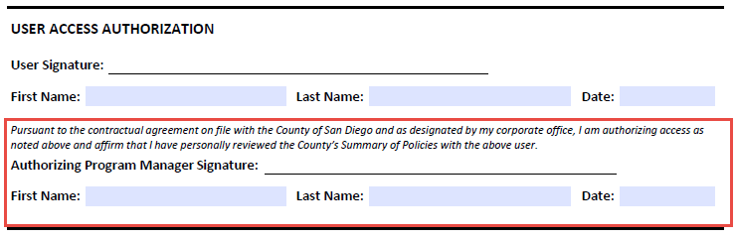
New User/Reactivate ARF Authorization
Program Managers sign
  If ARF is for Manager, someone higher must sign
Type PM name
Date must be on or after User’s signature date
Managers – make sure you know what you are signing!
Notes:
The Program Manager signs the next line. Type in the name and date signed.
Program Managers need to be aware that they are attesting that they agree with the ARF and are authorizing the user access to the EHR. Also, the PM is attesting that they have personally reviewed the County’s Summary of Policies with the user.
If a program manager is the user requesting access, this must be signed by someone higher up in the legal entity. A PM may not sign for themselves.
Signature date of the PM must be on or after the User signature date.

Slide 28
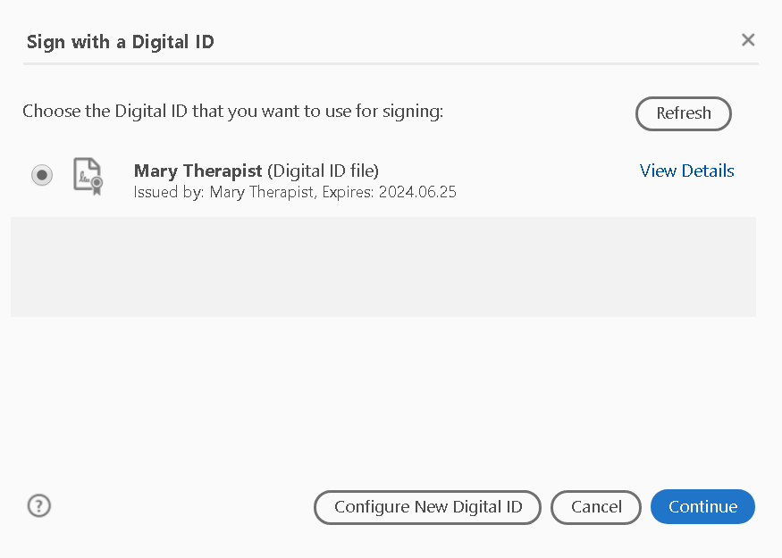

Select if you have a digital signature OR
Click Configure New Digital ID

Slide 29
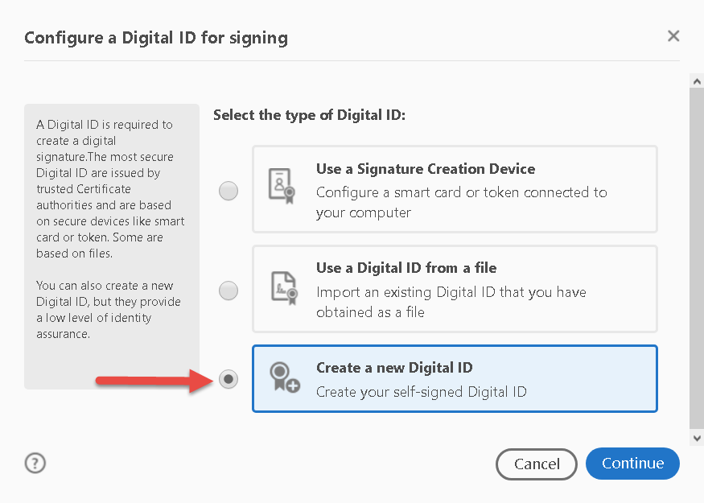
Click Create a New Digital ID

Slide 30
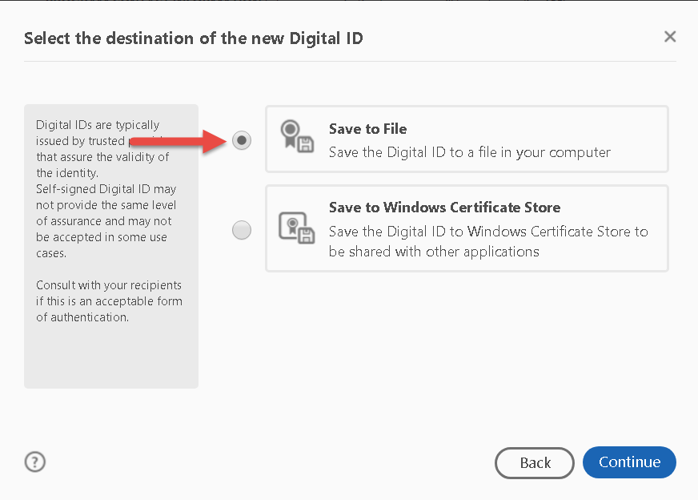
Save to File

Slide 31
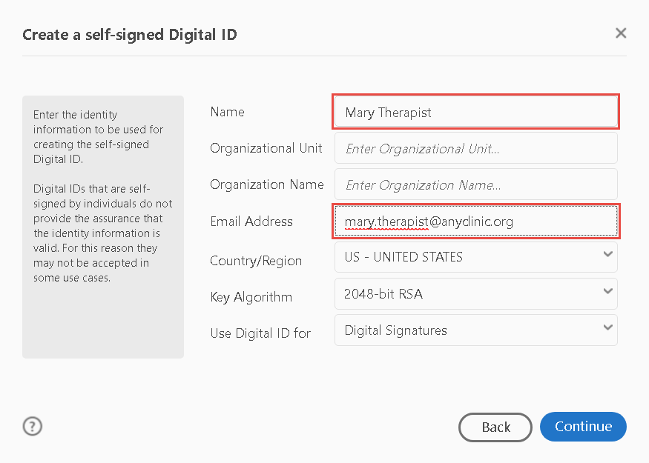
Enter info in required fields
Other fields are optional

Slide 32
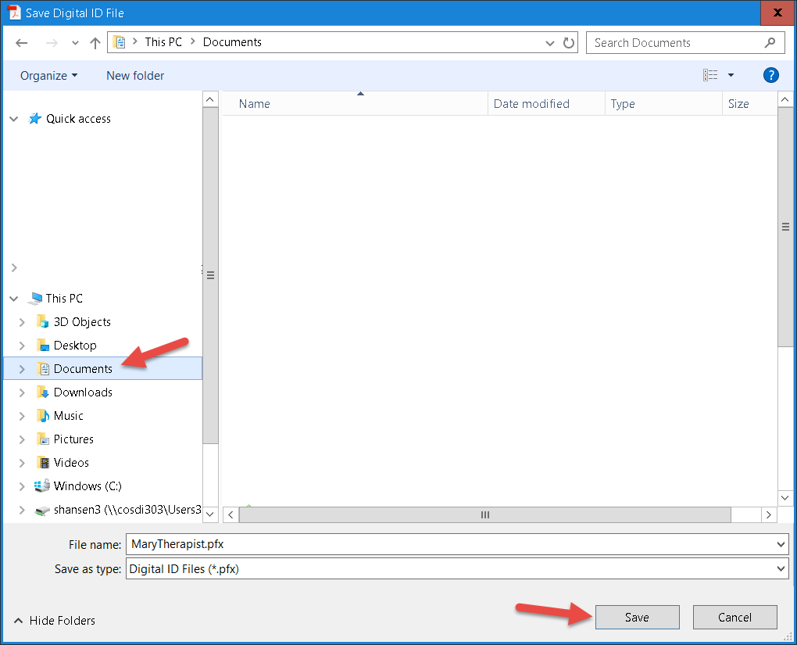
Where do you want to save it?

Slide 33
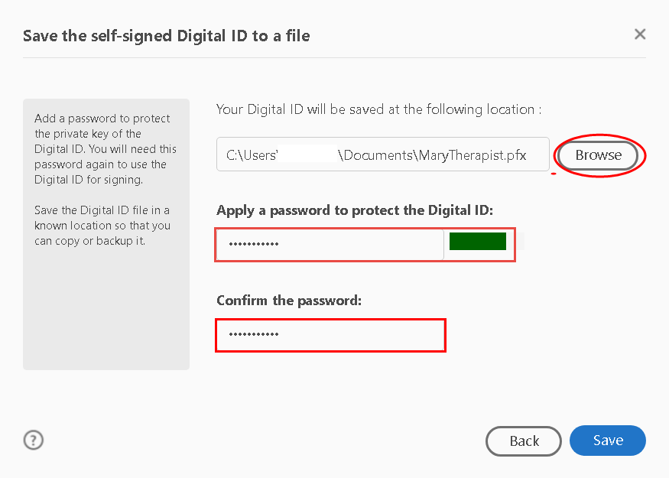
Give a password
Make sure it is secure

Slide 34
When the Prompt appears,
Select your ID if more than one
Continue

Slide 35
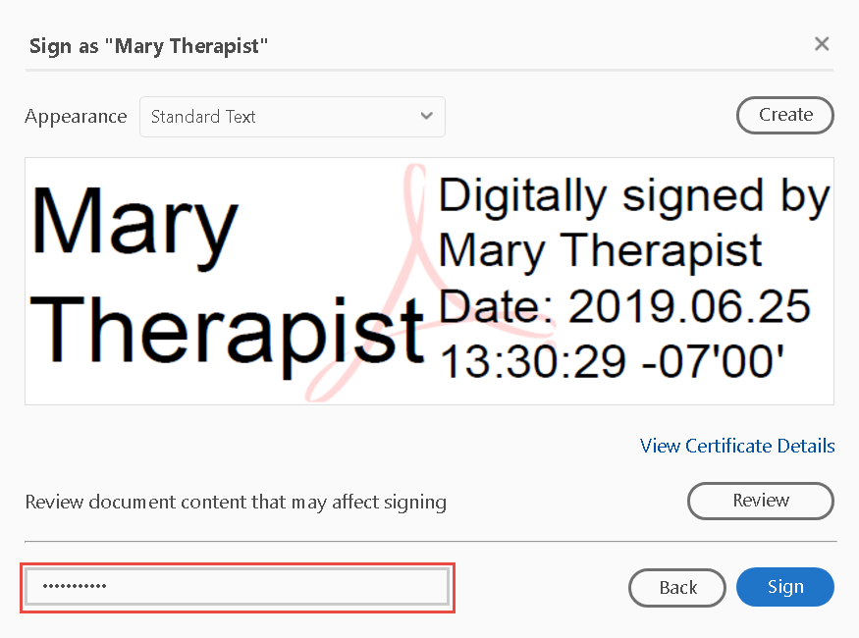
You may need to enter your password
Click Sign

Slide 36
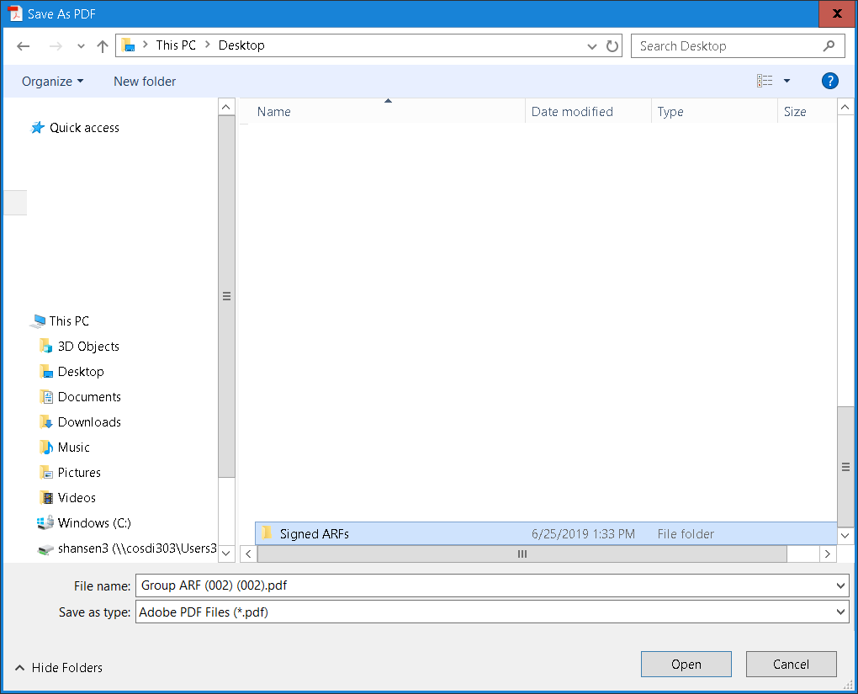
Save it

Slide 37
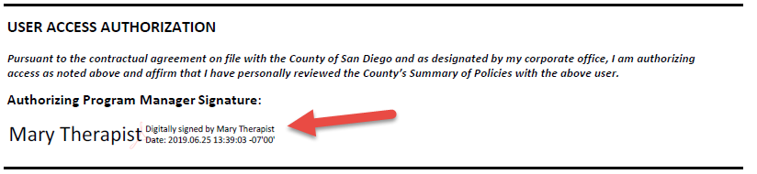
Here is your Digital Signature!

Slide 38
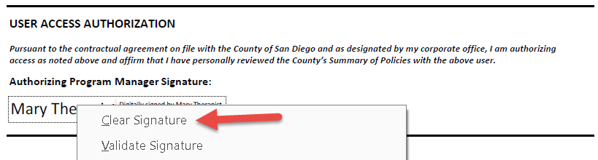
Oops!
Need to Edit?
  Made an error
  ARF was rejected
  Right Click:

Slide 39
Oops!
Make corrections
Re-sign
Only PM needs to do this part

Slide 40

NOT YET!!
Don’t click the Submit Button yet
Sign SOP/ESA forms

Slide 41
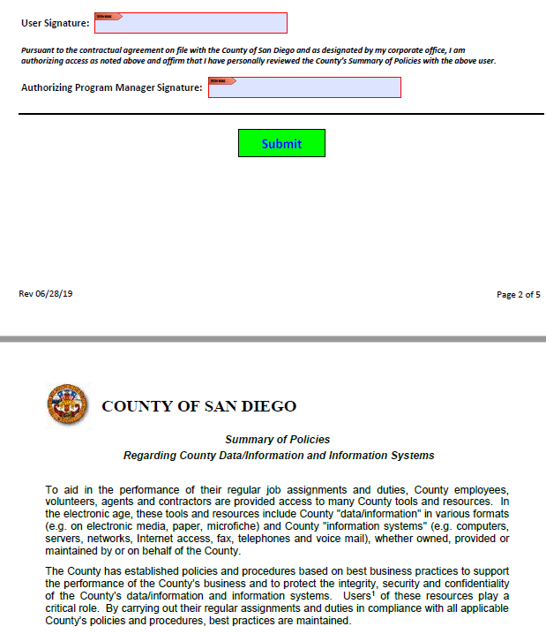
LOOK!
All ARF paperwork is attached

Slide 42
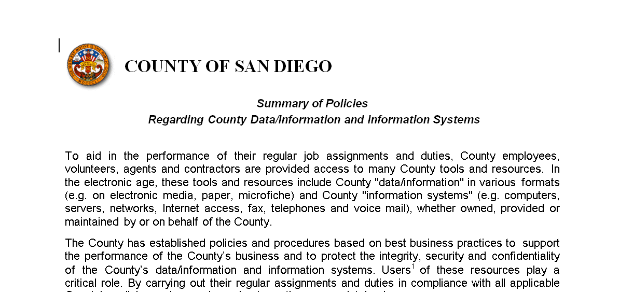
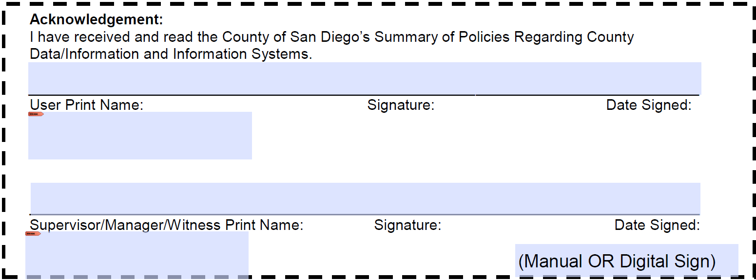

Summary of Policies (SOP)
Summary of Policies (SOP)
  Policies regarding use of the EHR
  Signed by all Non-County Staff
Latest Version
Notes:
The SOP is attached to the New User ARF and New User DHP ARF.

Slide 43
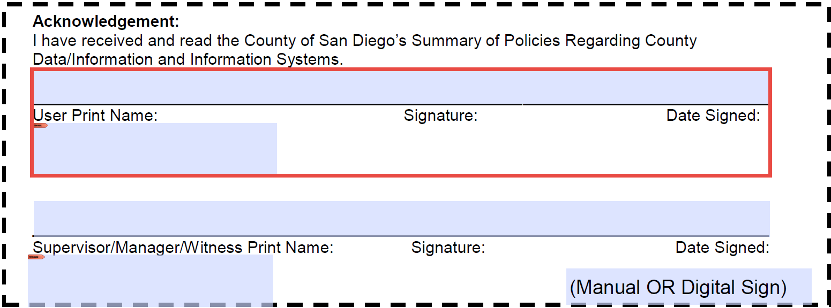
Summary of Policies (SOP)
User’s Name must be printed clearly
User sign’s legal name
Date of Signature
Notes:
The user’s name must be printed legibly. If the User prints their own name, make sure that it can be clearly read. If you can type it, make sure the name is spelled correctly.
User then signs and dates.
This form looks odd, because it was set up to allow County staff to digitally sign. If your Legal Entity has a digital signature feature, you may use it also. When it is printed out, you print the name and sign on the same line. If the name is long, please print the name below the line in the space.

Slide 44
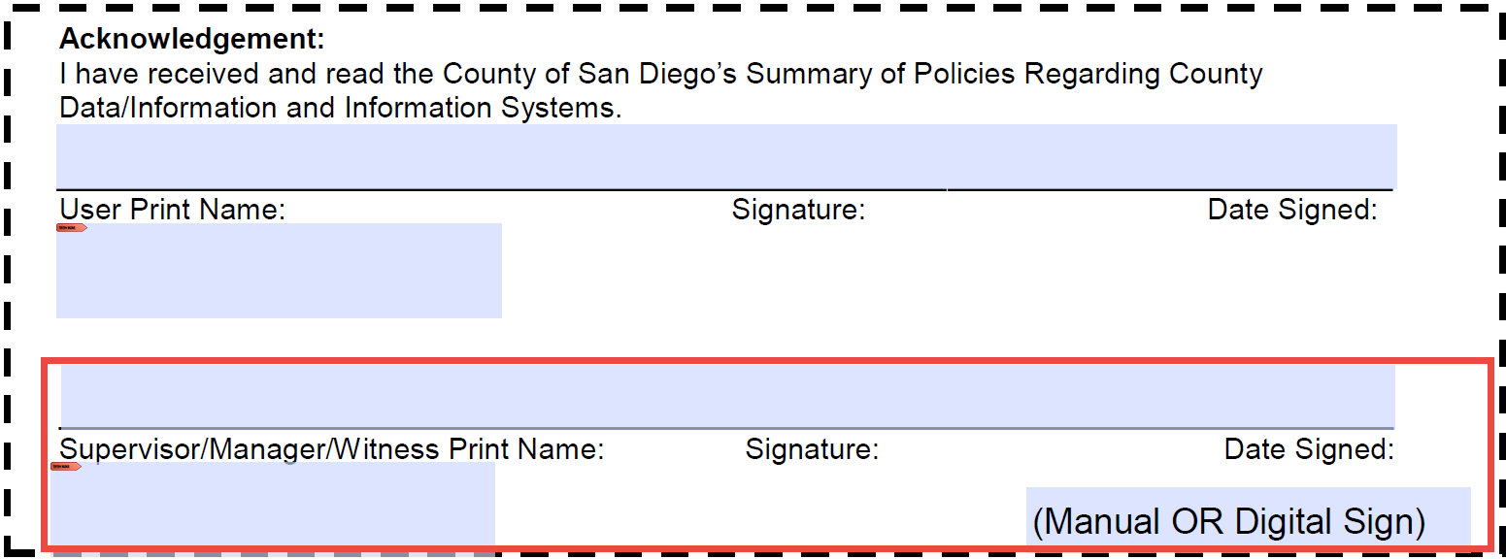
Summary of Policies (SOP)
Program Manager Sign and Date
  Date must be same or after User’s signature date
Notes:
The program manager also signs and dates. The date the pm signs must be on or after the date of the user’s signature.

Slide 45
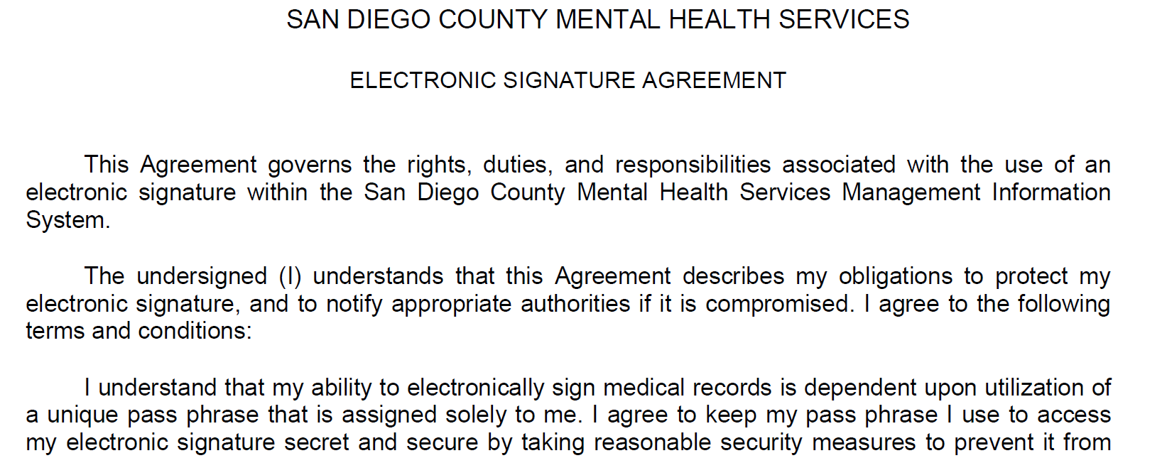
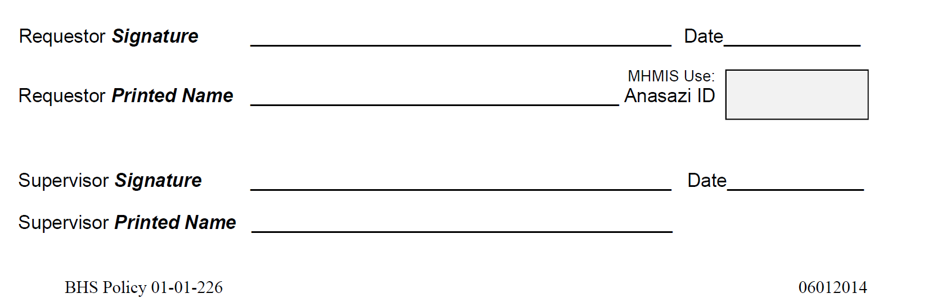
Electronic Signature Authorization (ESA)
Must be signed by all Users
  Print all names clearly
  Date of Supervisor must be on or after User signature date
Notes:
The Electronic Signature Authorization (ESA) is also required. This is attached to the New User ARF and the New User DHP ARF as well.

Slide 46

NOW!
When all paperwork is signed
  Both User
  And Program Manager
Click the Send Button

Slide 47


Done!
Automatically sends to
  MIS
  Optum’s Credentialing

Slide 48
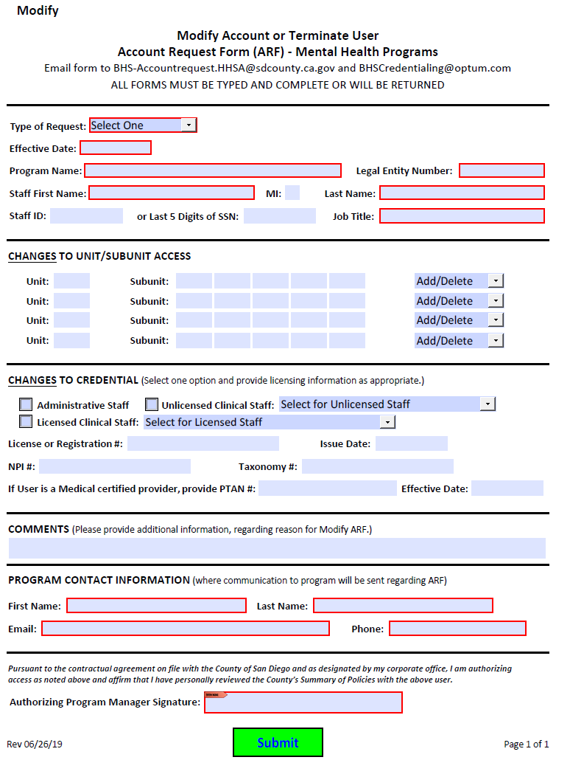
Modify User ARF

Slide 49
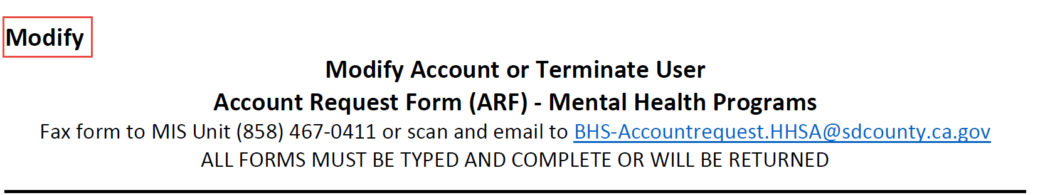
Modify User ARF
Use for any changes in a current account
  Change to Unit/SubUnits
  Change to Credentials
  Placing staff on Leave of Absence
Use for Terminating an account
Notes:
The Modify User ARF is for making changes to the active account. It is NOT for reactivating a dormant account, or reactivating an account on LOA.
Change to Unit/SubUnits (either adding or deleting)
Change of a Credential
Placing a Staff on a Leave of Absence
Minor changes to an account that won’t require new staff signatures/ SOP or ESA forms
User also for terminating an account. Make sure the user will not be in your legal entity.

Slide 50

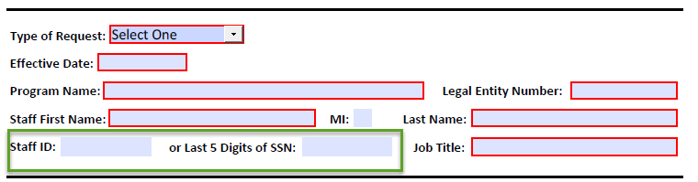
Modify User ARF
Select what is changing
Enter either the Staff ID or the SSN
If changing Job Title, enter the new one
Notes:
Select either Modify or Terminate. If not terminating from the legal entity, select Modify
We need either the Staff ID or the SSN. We must have one of them in order to process.

Slide 51
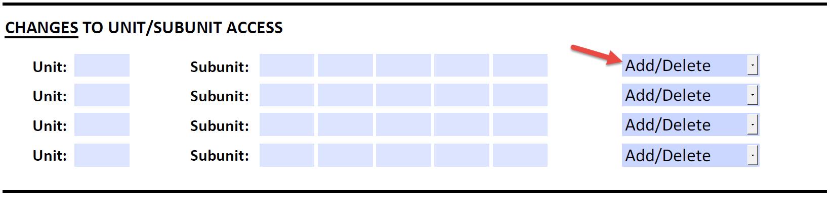
Modify User ARF
Enter all Units/SubUnits to be changed
Select Add or Delete
Reminder – If terminating, make sure you
have checked the user’s current U/SU
Notes:
Check the User’s account to see what Unit/SubUnits are in the account.
If you are only removing your Unit/SubUnits, please check ‘Modify” at the top of the form.
If you have selected Terminate, then the entire account will be terminated.
If Adding a Unit/SubUnit, just list the added ones.
If you are cleaning up an account, thank you!
Do not enter anything unless you are changing the Unit/SubUnit

Slide 52
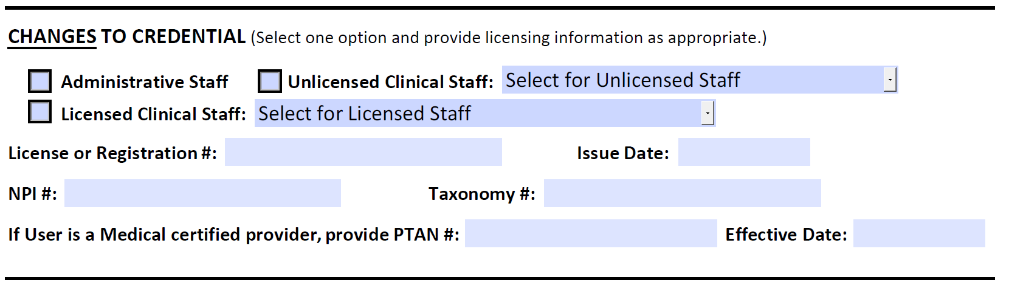
Modify User ARF
Only when changing a credential or a
Taxonomy
Or, adding PTAN to an account
Notes:
Do not use unless you are making a change to a credential, or adding PTAN to an account.

Slide 53
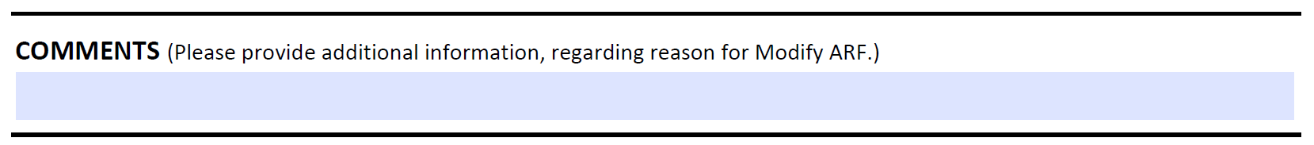
Modify User ARF
Make any comments, special requests in this section

Slide 54


Modify User ARF
Staff we can contact for information or to
report on processing the ARF
Make sure to enter correct email and phone
number
Not the clinician requesting access
  Should be Admin or Program Manager
Notes:
Same as for New ARF – someone we can contact regarding the ARF.
Do not allow a User to complete the ARF. This needs to be done by a Program Manager or designated Admin staff.

Slide 55

Modify User ARF
Program Manager signature is all that is
needed
Notes:
Only the PM signature is needed for Modifying Users.

Slide 56


Group ARF

Slide 57
Submit
When the Modify User ARF is signed
Click the Send Button

Slide 58

GROUP ARF
Common changes to more than one
account
For Modifications and Terminations
Notes:
The changes must be the same for all users

Slide 59


GROUP ARF
Select Modify Accounts or Terminations
Enter the date the changes will be effective
Enter the Program Name and LE number
Notes:
Select Modify or Terminate. However, remember that a termination will mean that all accounts will be closed, so make sure the users are not assigned to other Units/SubUnits in your legal entity.
Enter the Effective date of the change.

Slide 60

GROUP ARF
Staff ID and Names required
Add second page for more names
Notes:
Enter the Staff ID and Name for each staff – this is required.
If you need more space, you may add a second page, listing additional staff/ID’s – please put it in Table form.

Slide 61
GROUP ARF
Enter all Units/SubUnits to be changed
Select Add or Delete
Reminder – If terminating, make sure you
have checked the user’s current U/SU
assignments
Notes:
Enter the changes to the Unit/SubUnits and select Add or Delete.
If Terminating all staff, make sure you have checked their accounts to see if they are assigned to other Units/SubUnits in your Legal Entity.

Slide 62

GROUP ARF
Use the Comments section to give use any
information to clarify your request

Slide 63
GroupARF
Staff we can contact for information or to
report on processing the ARF
Make sure to enter correct email and
  phone number
Notes:
Same as for New ARF – someone we can contact regarding the ARF.
Do not allow a User to complete the ARF. This needs to be done by a Program Manager or designated Admin staff.

Slide 64

Group ARF
Program Manager signature is all that is
needed

Slide 65
Submit
When the Modify User ARF is signed
Click the Send Button

Slide 66

DHP ARF

Slide 67

DHP ARF
For medical staff who need access to
DHP product
MD/NP/DO – e-prescribing
RN – Clinical support
LVN – Clinical support
Notes:
DHP only used when an MD, DO or NP will be e-prescribing and for the nurses who will be supporting them.
Nursing staff must be linked to a Prescriber.
Prescribers may or may not be linked to a nursing staff.

Slide 68


DHP ARF
SelectType of user
  New
  Modify
  Terminate
Notes:
Select whether a New User, a Modify User or you are Terminating the User (for Terms, you may use the other Modify ARF as well)

Slide 69

DHP ARF
Select the type of Access
Enter the Program Name and LE

Slide 70

DHP ARF
Most info as on the ARF form
  FAX number for MD’s is required
Notes:
Note that we need a FAX number for the MD to receive from pharmacies. This must be a secure Fax.
Languages other than English, should be entered.

Slide 71

DHP ARF
Check appropriate boxes if staff will complete Assessments/Client Plans/Progress Notes
If staff requires a Supervising Physician, complete with that user’s ID
Notes:
Let us know what the clinician will be doing in CCBH.
If the staff requires a Supervising Physician, select Yes and enter the Supervising Physician name and Staff ID.

Slide 72
DHP ARF
Enter all Units/SubUnits
Select Add or Delete
Reminder – If terminating, make sure you
have checked the user’s current U/SU
assignments
Notes:
Enter the Unit/SubUnits and select Add or Delete.
If Terminating, make sure you have checked their account to see if they are assigned to other Units/SubUnits in your Legal Entity.

Slide 73


DHP ARF
For linking MDs/NPs to the support staff (nurses)
  You cannot link doctors to doctors
Enter the CCBH ID, name of the MD or NP that needs to be linked to the staff
Notes:
Nurses who will be supporting the MD
MD’s who need to be added to the Nurses’ menu
MDs do not get linked to other MDs.

Slide 74


DHP ARF
Select a credential
Complete the License Info:
Enter NPI and Taxonomy numbers
Notes:
Select the correct credential.
Complete all Licensing information. MD/NP/DO have a DEA number. Effective Date and Expiration Date are required
If MediCare provider, enter the PTAN and effective date.

Slide 75

DHP ARF
Use the Comments section to give use any
information to clarify your request

Slide 76
DHP ARF
Program Contact
Staff we can contact for information or to
report on processing the ARF
Make sure to enter correct email and phone
number
Not the clinician requesting access
  Should be Admin or Program Manager
Notes:
Section 8: Program Content
This is for staff that we can contact regarding the ARF. Usually it will be you. Make sure to add your email and phone number.
Please do not put the User name here.

Slide 77
DHP ARF Authorization
Send to the User
User adds digital signature
HOW TO CREATE
Click in the field

Slide 78
DHP ARF Authorization
Program Managers sign
  If ARF is for Manager, someone higher must sign
Type PM name
Date must be on or after User’s signature date
Managers – make sure you know what you are signing!
Notes:
The Program Manager signs the next line. Type in the name and date signed.
Program Managers need to be aware that they are attesting that they agree with the ARF and are authorizing the user access to the EHR. Also, the PM is attesting that they have personally reviewed the County’s Summary of Policies with the user.
If a program manager is the user requesting access, this must be signed by someone higher up in the legal entity. A PM may not sign for themselves.
Signature date of the PM must be on or after the User signature date.

Slide 79

License Information
  https://search.dca.ca.gov
Notes:
Enter the License Type (Licensed Clinical Social Workers, MD, RN, etc. There is a long list of license agencies)
Enter the License number if known
If License number is unknown, you can enter the name, then search for the name when a long list appears.

Slide 80

NPI/Taxonomy
https://npiregistry.cms.hhs.gov
Notes:
You will probably need to search by Name. To narrow the search, enter a city/state.

Slide 81
Choosing a Taxonomy
Choose a taxonomy appropriate to credential/Job Title
Some Rules:
  Only LCSW’s may use the 1041C0700X taxonomy
  LPCC’s must use 101YM0800X
If clinician must change a taxonomy, instructions are on Optum RegOnline
Notes:
Taxonomies are applied for by the clinical staff.
If you must change a taxonomy, instructions can be found on RegOnline
MIS has Guidelines for Choosing Taxonomies. You may request this through MIS.

Slide 82


Send all 3 forms together
Send to either:
  FAX
  Scan and Email to MIS email
Find the addresses at the top of the ARF
Do not send directly to MIS staff
Notes:
When you have the paperwork ready, send to either the fax number on the ARF, or scan and email to the address on the ARF. Send as ONE file.
Do not send them directly to MIS staff. The problem with that is that your paperwork may not be seen among all our other emails, or get forgotten. We may be away from the office, and not be able to access the attachments. In addition our Admin staff must vet the paperwork and if it doesn’t come through our official box, they won’t get to it in a timely manner either.

Slide 83

Training Guidelines
Register for training: www.regpacks.com/optum
Check status of ARF in 2 days
If ARF rejected, make changes and resubmit immediately
Account MUST be created 2 weeks prior to a training

Slide 84









Type – No Handwriting
Use Current Form
Send Terminations
Use the Comments Box
In 2-3 days
On SOP, ESA-Print Clearly
Leave of Absence? Send Modified ARF
Notes:
Final tips:
Make sure to type
Send in the Terms
Use current forms (we will return them if not the most recent)
Make sure names are printed clearly (we will return them if we cannot read them)
Send in Modified ARF’s for staff on Leave of Absence to avoid them losing their CCBH and Citrix accounts
Follow up in 2-3 days to see if we received the ARF and what the progress is.
Ask questions if unsure.
Any questions?

Slide 85


Help!!
Regpacks has help!
www.regpacks.com/optum
Notes:
You may access forms and tip sheets on RegOnline

Slide 86

Help!!
Check this often for new forms, etc

Slide 87
Questions?
MIS Help Desk – 619-584-5090
MHMIS Mailbox MH_MiS_SystemAdmin.HHSA@sdcounty.ca.gov
Notes:
Here is our Help Desk number and the MHMIS mailbox. Please feel free to ask anything. We are very willing to assist you in being successful!
Thanks for coming today.

