Slide 1
BHS Billing Unit
Billing Office Hours
October 23, 2026

Slide 2

Meeting Agenda
BHS BU New Contact Info
SOC (System of Care) Reminder:
  Charges staged to 9999 plan have been reviewed/resolved – focus on DOS that is fast approaching timely filing deadline with DHCS (12 months from DOS).
  SmartCare Client Plan Request should be submitted for clients with no coverage or lapsed coverage on CoSD Client Insurance and Date Span Report
  Charges staged to Private Insurance and Medicare plans have been billed. Submit EOBs to MHBillingUnit or SUDBillingUnit where applicable.
  Review/Resolve Service Errors
Client Information and Medi-Cal Billing
  Monthly Medi-Cal Eligibility File (MMEF)
  Client Name in SC vs Client Name in MMEF
  Retroactive Medi-Cal Coverage
  CoSD 814 – Claims Denial Contractor Report
  SMHS & DMC-ODS Service Tables
CalMHSA 120 – BH Connect Monthly Services Report
Data Quality
Q&A

Slide 3

BHS Billing Unit Contact Information
Last reminder to please send all MH and SUD billing communications to the following BHS Billing Unit email addresses:
MH billing and billing-related emails to: MHBillingUnit.BHS@sdcounty.ca.gov
ADP or SUD billing and billing-related emails to: SUDBillingUnit.BHS@sdcounty.ca.gov
Electronic Fax (eFax)
MHBU: 858-467-9682
SUDBU: 619-236-1418
NOTE: Documents submitted via electronic fax will automatically point to the associated email address.

Slide 4
Client Information and Medi-Cal Billing
The client's name in SmartCare Client Information must match exactly what is on file in the state's Medi-Cal systems (such as Medi-Cal Provider Portal, MEDSLITE, MEDS, or the Benefits Identification Card). Failure to align the name formatting precisely may result in the Medi-Cal plan not being added automatically for a full scope Medi-Cal client's coverage and time plans in SmartCare when the MMEF file is uploaded, resulting in charges dropping to 9999.
Key Consequences of a Mismatch:
When the Monthly Medi-Cal Eligibility File (MMEF) or automated eligibility checks run, the system attempts to reconcile the internal SmartCare records with the state's MEDS (Medi-Cal Eligibility Data System) database.
The Matching Logic: The system typically uses a strict multi-point match, including First Name, Last Name, Date of Birth (DOB), and Social Security Number (SSN) / Client Index Number (CIN).
The Risk of Formatting: Even minor discrepancies such as a missing hyphen, an extra space, a middle initial included in the first name field, or a suffix (like Jr. or III) placed incorrectly—will cause the matching algorithm to fail.

Slide 5
Medi-Cal Claim Denials
BHS Programs should run and review the CoSD 814 Claims Denial Contractor Report (My Office) monthly or as often as needed.
For guidance on CoSD 814 Report, please refer to the CoSD 814 – Claims Denial Contractor Report (Medi-Cal Only) document published by the BHS Billing Unit in San Diego Optum Resources SMH & DMC-ODS Health Plans- Billing section.
Currently, the Adjustment Reason Code "143" is described as 'Claim Filed Late' in the CalMHSA 814 Report. But it doesn't signify "late claim filing as CARC 143 means a portion of payment is deferred". CalMHSA has informed that changes are being made to the 143 description. BHS BU will provide an update once the change has gone into effect. Feel free to reach out to the BHS BU for any additional assistance.
Please reach out to your designated BHS billing team if you need further clarification or assistance with resolving denied claims.

Slide 6
CARC & RARC
The CARC (Claim Adjustment Reason Code) and RARC (Remittance Advice Remark Code) are standardized codes provided by insurance companies to explain why a medical claim was denied, reduced, or paid differently than billed.
CARC and RARC are included in the electronic remittance advices (ERAs) or explanations of benefits (EOBs) that the BHS Billing Unit posts to SmartCare.
The CARC and RARC tables are posted on the BHS Optum Billing resources website for your reference.
MH CARC and RARC
SUD CARC and RARC

Slide 7
Retroactive Medi-Cal
As of October 2026, a feature has been configured in SmartCare to update current and historical Medi-Cal coverage per the MMEF (Monthly MEDS Extract File). When a new MMEF provided by DHCS is imported into SmartCare by the BHS Billing Unit at the beginning of each month, SmartCare will now update the Medi-Cal DMC and Medi-Cal MH Coverage Time Spans on the Client Plans screen based on a client’s eligibility for the current month and the previous 12 months.
As a result of configuring this feature in SmartCare, programs may notice a considerable reduction in the number of charges displayed when running the CoSD Charges/Claims Report and filtering by the “9999” Coverage Plan. This is expected and desired.
For any other inquiries related to 9999, especially if you're aware that the client is Medi-Cal eligible, please reach out to your assigned BHS billing team.

Slide 8
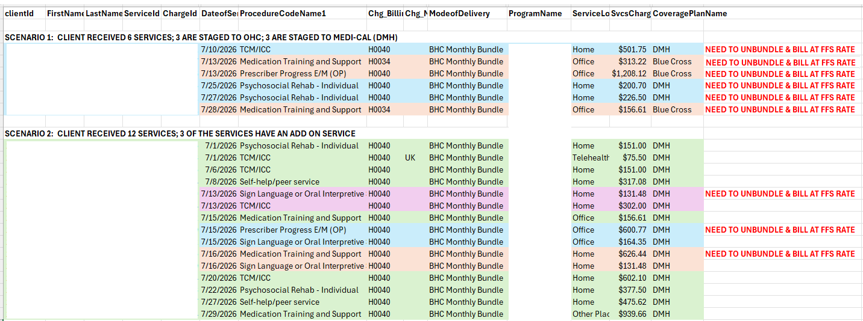
BH Connect Monthly Services Report
Notes:
You should still document your Client’s consent preferences, even if they decline the disclosure of any data authorized by the Form by selecting the “No” checkbox. This avoids re-requesting your Client’s consent to share their data and records their request to not share that data.
Signing the Form is optional, and your Client may decline to complete the Form.

Slide 9
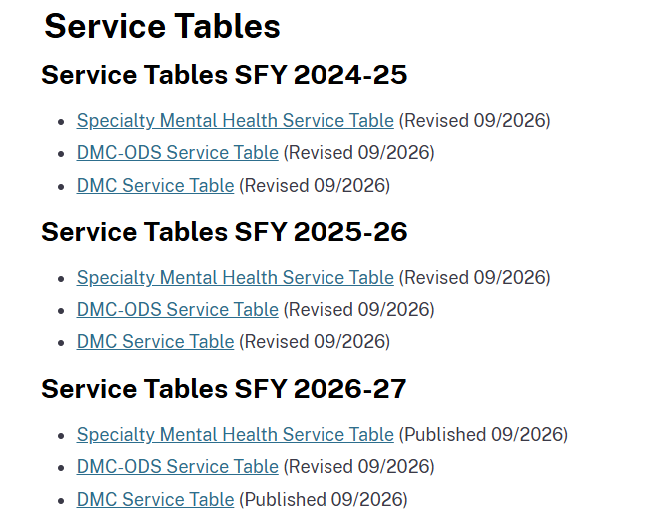
SMHS & DMC-ODS Service Tables
Updated Service Tables now available on MEDCCC website

Slide 10

Report Training and Resources
Current Efforts
  Optum SmartCare Training
  SmartCare Help Desk Support
  SmartCare ARF: Treatment Programs
  Centralized E-mail support:
  BHS-DataScience.HHSA@sdcounty.ca.gov

Slide 11
Who to Contact?
Who to Contact | How to Contact
SmartCare System issues: i.e. glitches, functionality issues, pop-up errors | CalMHSA various options: 1. Connect via Live Chat (M-F 8:00am – 5:00pm) a. 2023.calmhsa.org b. Access when logged in to the SmartCare EHR 2. Submit a ticket (M-F 8:00am – 5:00pm) a. 2023.calmhsa.org b. Access when logged in to the SmartCare HER 3. After Hours support (only available for system outages) a. Call (916) 214-8348
Password Resets and Account Unlock | Call 1-800-834-3792 (Available daily from 4:30am – 11:00pm including weekends and holidays)
SmartCare ARF submission and any access related issues or questions | BHS_EHRAccessRequest.HHSA@sdcounty.ca.gov
SmartCare support questions that cannot be addressed by the CalMHSA Support Desk should be directed to MIS | BHS_EHRSupport.HHSA@sdcounty.ca.gov
For questions related to documentation guidelines, DHCS regulations or policy | QIMatters.HHSA@sdcounty.ca.gov
Billing Issues or Questions that cannot be addressed by the CalMHSA Help Desk | Mental Health: MHBillingUnit.BHS@sdcounty.ca.gov MH Billing Line: 619-338-2612 SUD: SUDBillingUnit.BHS@sdcounty.ca.gov SUD Billing Line: 619-338-2584
Reports and Data Questions | BHS-DataScience.HHSA@sdcounty.ca.gov

