Slide 1
Quality improvement
6th annual knowledge forum
July 12, 2019
Welcome and
Thank You for your outstanding commitment
to client care!

Slide 2

The QM TEAM at our Annual Advance “retreat”
Marc,
facilitator
Steve
KC
Dave
Marie
Claire
Danielle
Monica
Michael
Lisa
Casie
Glenda
Nicole
Christian
Not present: Amber, Heather, Tes

Slide 3
The little things first . . .
Bathrooms
Breaks
Silence Phones
Taking Questions

Slide 4
BHS QI leadership team - MHP
Tabatha Lang, Quality Improvement Team Administrator
Steve Jones, Behavioral Health Program Coordinator, MHP QM
  Heather Parson & Casie Johnson-Taylor – QM Supervisors MHP QM
Liz Miles, Principal Administrative Analyst, Performance Improvement Team (PIT)
  Christopher Guevara, Administrative Analyst III
AnnLouise Conlow, MIS Program Coordinator
  Stephanie Hansen, Administrative Analyst III

Slide 5
bhs director luke Bergmann, Ph.d.

Slide 6
SYSTEM INFORMATION
Presented by
Tabatha Lang, LMFT
Quality Improvement Unit Administrator

Slide 7
DHCS MONITORING
Triennial Reviews
POC Validations
Statewide or Regional Technical Assistance and Training
MHP Submission of Evidence of QI Actions
Targeted MHP Specific Trainings
POC Validation Visits
Focused Desk Reviews
Focused, Modified or Comprehensive Onsite System and Chart Reviews
Administrative and Financial Sanctions

Slide 8
2017/18 MHP system and Chart review by dhcs
OVERALL SCORE | 97.3% | TOTAL CLAIMS = 367 | DISALLOWED CLAIMS = 10 (2.7%)
MEDICAL NECESSITY |  | 100%
ASSESSMENT |  | 98.2%
MED CONSENT |  | 100%
CLIENT PLAN |  | 84.1%
PROGRESS NOTES |  | 99.5%
CULTURAL COMP |  | 100%
DAY TREATMENT |  | No claims reviewed

Slide 9
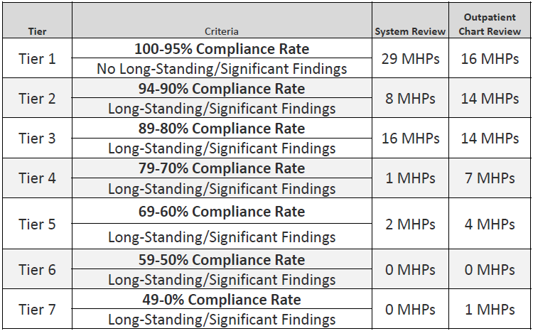
Mhp tier distribution

Slide 10
Dhcs training
Chart Documentation E-Learning Modules:
  DHCS is working on developing training modules to assist with documentation.
  Modules 1-4 are being developing to be released soon, with 5-8 coming next fiscal year
    1. Overview: Recovery and Documentation
  2. Assessments
  3. Client Plans
  4. Progress Notes
  5. Medication Consents
  6. Inpatient Documentation
  7. Preparing for a Compliance Review
  8. Supervising Documentation Practices

Slide 11
Update on CYF Initiatives
Continuum of Care Reform: Key Components
Requires final transition of group homes to Short-Term Residential Therapeutic Programs (STRTPs).
Establishes a new structure and level of care protocol for placing agencies to use to determine needs and payment.
Defines functions of the Child and Family Team (CFT) and how to use the CANS to inform treatment progress and decisions.
Expands the role of Foster Family Agency (FFA) to provide multiple levels of care and enhances FFA licensing standards.
Requires all new families to be approved as Resource Families (RFs).

Slide 12
Children’s Crisis
Residential programs (CCRP)
Assembly Bill (AB) 501 (Chapter 704, Statutes of 2017) authorized the California Department of Social Services (CDSS) to license a Short-Term Residential Therapeutic Program (STRTP) to operate as a CCRP and authorized the Department of Health Care Services (DHCS) to approve the children’s crisis residential mental health program at the CCRP.
CCRPs serve children experiencing mental health crises as an alternative to psychiatric hospitalization.
CCRPs are a type of community care facility, and are, by definition, non-medical residential facilities.
Provides short-term crisis stabilization with “Therapeutic Intervention” and “Specialized Programming.”

Slide 13
From Crisis to chronic care
Update: continuum of care
Specialty Care
Chronic Illness Management
Crisis
Services
Crisis Services
Specialty Care
Chronic Illness Management
Prevention
Notes:
LUKE BERGMANN
And this isn’t even yet to mention prevention, which is currently a small portion of our overall budget and the broader community spending. In terms of cost to yield, prevention work should be our bedrock and remains our best investment.
[next slide]

Slide 14
Update: continuum of care
Governance and Data
Care Coordination
Crisis Stabilization and Harm Prevention
Post-Acute/Long-Term Care
Bridging Behavioral Health and the Justice System

Slide 15
Crisis Stabilization and Harm Prevention
Update: continuum of care
Phase 1: Invest in Hospital and Community-Based Crisis Services
Expand and optimize Palomar Health’s existing Hospital-Based Crisis Stabilization Unit (CSU) in Escondido
Establish two new Community-Based CSUs in North County with law enforcement drop-off and connections to non-law enforcement crisis response
Notes:
LUKE BERGMANN
Our response is a multi-pronged and phased approach, leveraging efforts across healthcare and public safety, and reflecting the direction of this Board.
Our first effort, commencing today, pending your approval of recommendation #2, item 4, will be to double the size of and optimize hospital-based crisis stabilization services for behavioral health at Palomar Health’s Escondido campuses. This involves the devotion of an additional $4.4 M in Fiscal Year 2019-20, and approximately $6.4M in Fiscal Year 2020-21 to expand contracted services.
It is anticipated that upon full implementation of these services, federal revenue to help offset costs will be better maximized, and efficiencies in other service delivery areas, including reductions in inpatient and psychiatric care, will be realized.
We are also seeking to establish additional Community-based CSU’s in North County. While hospital based CSU’s are important to manage ongoing behavioral health flow into emergency departments and to divert inpatient admissions, Community-based CSU’s, which can be proximate to but aren’t formally within hospital systems, have the advantage of much faster drop-off times for law enforcement and easier access for some community members.
You will be hearing more about Community-Based CSU’s, per item #1 on today’s agenda, from our public-safety partners later in this presentation.
[next slide]

Slide 16
Crisis Stabilization and Harm Prevention
Update: continuum of care
Phase 1: Invest in Hospital and Community-Based Crisis Services
Expand and optimize Palomar Health’s existing Hospital-Based Crisis Stabilization Unit (CSU) in Escondido
Establish two new Community-Based CSUs in North County with law enforcement drop-off and connections to non-law enforcement crisis response
Phase 2: Develop Alternatives to Inpatient Hospitalizations
Explore flex-bed model within North County health districts for psychiatric health facility (PHF) and crisis residential beds.
Notes:
LUKE BERGMANN
Phase 2 of efforts in North County will involve the establishment of an innovative 16 flex-bed inpatient and residential care model on Palomar Health’s new campus, using a combination of psychiatric health facility and crisis residential resources to be most responsive to current patient needs and to allow the service to evolve over time - staff is exploring feasibility, for example, for facilities to change from one use type to another as community needs change.
As you are aware, item #23 on today’s agenda docketed by District 5 may impact the landscape in North County.
And again, while early efforts are focused on mapping and addressing service needs in North County due to immediate term needs, the intention is to similarly map out needs across the behavioral health continuum across all regions of the County.
[next slide]

Slide 17
Follow Up to Law Enforcement Contact
Update: continuum of care
  Tiered approach depending on acuity of crisis and safety risk
  Highest acuity: PERT with follow-up
  Middle acuity: NEW non-law enforcement mobile crisis teams
  Lowest acuity: Telephonic follow up with connection to services
Notes:
RACHEL SOLOV
Not every person, case or crisis is the same - there are varying levels of intensity. Therefore, we are proposing a tiered approach that bases the level of response on the level of need with the ultimate goal being to efficiently and expediently move a person from law enforcement contact to health care contact and engagement.
Lower level intensity would receive a lower level response, perhaps telephonic outreach to connect someone or a family member to services. Higher intensity crises would receive a higher level of response. PERT will continue to respond to these calls as they do today. However, a coordinated system of follow up will be implemented to connect people to behavioral health services if the person is not transported to jail or a hospital or, in the future, to community based crisis stabilization.
For those who fall between a low level and a high level, and who are not transported somewhere, law enforcement will have a new tool in their tool box: non-law enforcement mobile crisis teams. For situations where a purely clinical response is most appropriate, these mobile crisis teams will be able to respond in lieu of PERT or law enforcement. In appropriate cases, this will allow for a medical response vs. a law enforcement response.
[next slide]

Slide 18
Post-Acute/Long-Term Care
Update: continuum of care
Investments in Post-Acute Services
Notes:
LUKE BERGMANN
We are also exploring how best to ensure that post-acute services are readily available to those stepping down from crisis services.
As you are aware, an item on today’s agenda docketed by Supervisor Gaspar focuses on establishing an additional 70 short-term recuperative care beds for people being discharged from hospitals, with priority access being given to homeless individuals with behavioral health conditions.
[next slide]
Hip pocket
D3 Tip the Scale BL is specific to those discharged from Tri-City, Palomar or VA (language below lifted from recommendation #7, pg 2)
7. Pursuant to California Government Code section 26227, direct the Chief Administrative Officer, or designee, to negotiate with Interfaith Community Services or related entity, and upon successful negotiations, enter into an agreement or agreements to provide funding to assist it in purchasing property located in Escondido, California, subject to the following conditions:
Interfaith Community Services or related entity will create a mixed-use facility and each bed in the facility will be dedicated as either a recuperative care bed or temporary shelter bed;
Interfaith Community Services or related entity will dedicate all recuperative care beds to those individuals who are eligible to receive publicly funded insurance such as Medi­Cal, County Medical Services, or are Veterans Administration benefits eligible, with priority given to individuals discharged from a Palomar Hospital District, a Tri-City Hospital District or a Veterans Administration facility;
Interfaith Community Services or related entity will dedicate all temporary shelter beds for those individuals who are indigent and either homeless or unstably housed with priority given to homeless individuals who reside within the boundaries of either the Palomar Hospital District or the Tri-City Hospital District; and
The property will be used for the purposes set forth in this recommendation for a term commensurate with the useful life of the building, and should that use cease during that time, the property will transfer to the County or the funds provided by the County will be repaid to the County on the terms set forth in the funding agreement.

Slide 19
BHS OPERATIONAL PLANS
FY 2011/12 – 2019/20
Notes:
This chart depicts the growth of the BHS budget since fiscal year 11/12. As you can see the budget was relatively flat through FY 15/16.
From FY 16/17 the budget increased by $28.5 million (approx 6%), primarily related to the expansion and enhancement of MHSA programs.
The BHS budget for FY 18-19 represented a $129.1M increase over FY 17-18, at change of 24.4%, with the majority of this increase resulting from the Drug Medi-Cal Organized Delivery System implementation.
And now with the FY19/20 budget we see an increase of $50.3M, as we continue to grow our MHS and LTC beds, and make one-time investments in modernizing our IT systems. I will detail some of the significant additions in a later slide.
It is noteworthy to mention that from F17/18 to FY19/20 there has been a growth of $179.4M in the BHS budget…a 34% growth…as we continue to invest in behavioral health services.

Slide 20
Fy2019-20 CAO recommended budget
TOTAL BHS BUDGET: $708.5 MILLION
Notes:
BHS’ Recommended Budget for FY19/20 is $708.5M. This represents 30.8% of the HHSA $2.3 Billion dollar budget, comprising the largest percentage of the overall HHSA budget.
Of the overall FY19/20 Recommended Budget
58% of the budget supports Mental Health Services at $408.2M.
28% supports Substance Use Disorder Services $186.1M
Followed by Sd Psych Hospital 6.4% ($45.6M)
Edgemoor 6.2% ($43.8M)
Administration 3.5% ($24.8M).
(Note: MHS includes clinics, adult case management, forensics, and pharmacy expenses).
As this Board knows, most of our services are delivered through contract providers, therefore a majority of the budget is associated with contract cost which for FY2019-20 total $559.4M, which is 79% of the total budget. These totals are divided :
Inpatient: $15.0M in contract costs
AOD: $181.0M contract costs
MHS: $363.4M contract costs
Total: $559.9M
Approx. 28.8% of contracts are for CYF ($161.2M)
Approx. 68.5% of contracts are for AOA ($383.2M)
Approx. 2.7% of contracts for IHS ($15.0M)

Slide 21
“mega regs” update
Network Adequacy
Provider Directory
Provider Enrollment
Credentialing

Slide 22
Network adequacy
Certification Tool completed quarterly for MHP, annually for DMC-ODS
Submission is a condition for receiving Federal Financial Participation
Financial sanctions if Plans fail to submit complete, accurate and timely
Utilizing the information programs are providing to develop a System of Care Database to streamline processes
Notes:
Timely Access
From request to appointment
Time and Distance
Legal Entity, Provider Site and Rendering Provider details
Provider Counts (FTE for staffing ratios)
Service utilization expectations by service type/modality
Geographic Access Maps
Language Line Utilization Charts
Grievances and Appeals related to access (and resolutions)
Satisfaction Survey results related to network adequacy or timely access (MHPs only)

Slide 23
Provider directory
New Content Required
Maintenance Requirements
Will merge FFS and Org Provider Directories next FY
Notes:
The provider’s cultural capabilities (e.g., veterans, older adults, Transition Age Youth, Lesbian, Gay, Bisexual, Transgender);
The provider’s linguistic capabilities including languages offered (e.g., Spanish, Tagalog, American Sign Language) by the provider or a skilled medical interpreter at the provider’s office; and,
Whether the provider’s office / facility has accommodations for people with physical disabilities, including offices, exam room(s), and equipment
Type of practitioner, as appropriate;
National Provider Identifier number;
California license number and type of license; and,
An indication of whether the provider has completed cultural competence training
Wait times
Updated at least monthly
Will use the SOC Provider Database just discussed to remain compliant

Slide 24
Provider enrollment & credentialing
Effective July 1, 2019
New providers will be prioritized during phased implementation approach
Optum working with each LE to finalize processes
Leveraging activities to streamline enrollment and credentialing
Delegated entities will be monitored by Optum

Slide 25
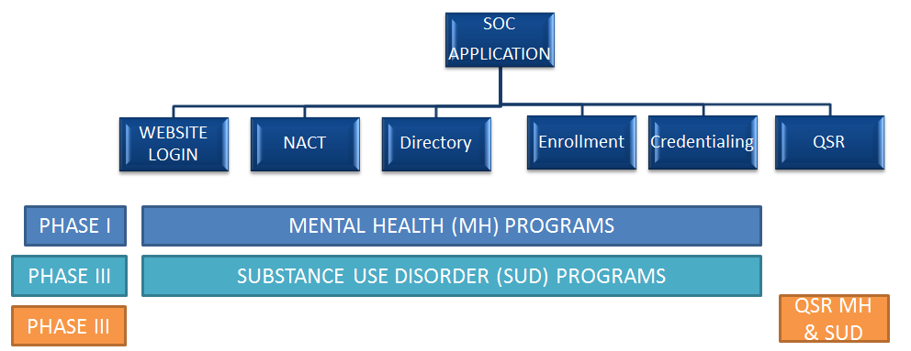
System of Care (SOC) Application
System of care (soc) application
In the fall of 2019, the County will be releasing the first phase System of Care (SOC) Web Application hosted and managed by Optum
This application will be comprised of 6 components

Slide 26
System of care (soc) application features
No redundancy: One login/registration for components
Security: Registered and verified users will be given access to data that pertains to them and the program(s) they work for
Support for multiple views of data: County Administrators, Program Managers, and Rendering Providers will have unique access
Data management: Will reduce the amount of duplicative data entry and time managing NACT submissions
Data integrity: Will Increase data integrity in reporting and across systems
Communication tools: Workflows to communicate changes to responsible parties

Slide 27
COUNTY SYSTEM OF CARE
Presented by
Steve Jones, LCSW, QM BH Program Coordinator
Casie Johnson-Taylor, LMFT, QM Supervisor
Claire Riley, LMFT, QM Specialist
Michael Blanchard, LMFT QM Specialist
Danielle Rhinesmith, LMFT, QM Specialist

Slide 28
MRR Results FY18-19
ASSESSMENT |  | SOC | CYF | A/OA
1 | Demographic form is completed and previous information is reviewed/updated within 30 days of program assignment. | 90% | 95% | 86%
2 | Demographic form is updated if there was a change in client information after admission and at a minimum annually. | 68% | 67% | 70%
3 | Initial BHA was final approved within 30 calendar days of program assignment (date of assignment counts as day one). | 91% | 94% | 88%
4 | In the BHA covering the review period, the BHA was updated as indicated or at a minimum of annually from previous BHA final approval date. | 70% | 86% | 54%
5 | In the BHA covering the review period, presenting problem documents how client meets or continues to meet medical necessity. | 94% | 96% | 92%
6 | In the BHA covering the review period, documentation evidences a cultural formulation which includes an understanding of how or if culture impacts client's mental health. | 85% | 87% | 82%
7 | In the BHA covering the review period, the Sexual Orientation question has been assessed and answered. | 98% | 99% | 97%
8 | In the BHA covering the review period, the Gender Identity question has been assessed and answered. | 98% | 99% | 97%
9 | In the BHA covering the review period, the Domestic Violence questions have been assessed and answered. | 98% | 99% | 96%
10 | In the BHA covering the review period, the Trauma questions have been assessed and answered. | 97% | 99% | 96%

Slide 29
MRR Results FY18-19
ASSESSMENT |  | SOC | CYF | A/OA
11 | In the BHA covering the review period, past and current substance use and its impact on client functioning is documented and diagnosed, if applicable. | 71% | 72% | 70%
12 | In the BHA covering the review period, if any item on the HRA is marked "yes", the Protective Factors and Self Injury/Suicide/Violence Management Plan fields are completed. | 79% | 82% | 75%
13 | Within the past year (from date of current MRR), when a client has discharged from a 24 hour facility (Hospital, Crisis House) for DTS/DTO, a High Risk Assessment (HRA) is completed. | 70% | 82% | 58%
14 | In the BHA covering the review period, documentation indicates client was asked if he/she has a primary care physician (PCP). If client does have PCP, contact information is included or reason documented why not. | 97% | 97% | 96%
15 | In the BHA covering the review period, if client does not have a PCP, client was advised to seek a PCP. | 87% | 85% | 89%
16 | The BHA covering the review period includes a clearly substantiated Title 9 primary diagnosis. | 97% | 98% | 95%
17 | Clinical Formulation documents that Diagnosis Form has been reviewed if diagnosis is unchanged. If making a new diagnosis, the Diagnosis Form is updated to reflect this change. | 88% | 93% | 82%
18 | In the BHA covering the review period, the Clinical Formulation documents how client's symptom(s) impact current functioning. | 88% | 90% | 86%
19 | In the BHA covering the review period, the Clinical Formulation documents proposed plan of care/services to address the client's behavioral health needs. | 96% | 96% | 95%

Slide 30
MRR Results FY18-19
CLIENT PLAN |  | SOC | CYF | A/OA
20 | Initial Client Plan was completed and final approved within 30 days of program assignment (date of assignment counts as day one) and contains all required signatures or reason documented why not signed or final approved. | 91% | 92% | 90%
21 | A new and updated Client Plan covering the review period was written and final approved annually or reviewed at UM (CYF only) and contains all required signatures or reason documented why not signed or final approved. | 63% | 74% | 52%
22 | Documentation evidences that the Client Plan was explained to the client or family/legal guardian in his/her primary language. | 98% | 99% | 97%
23 | Documentation evidences that the client or family/legal guardian was offered a copy of the plan or reason why not offered. | 96% | 98% | 95%
24 | The Client Plan covering the review period is documented with specific client strengths that are applied towards client goals and objectives | 91% | 93% | 89%
25 | The Client Plan covering the review period documents that Area of Need(s) is linked to symptoms/behaviors and level of impairment affecting functioning that were identified in BHA and linked to the diagnosis for the focus of treatment. | 92% | 94% | 89%

Slide 31
MRR Results FY18-19
CLIENT PLAN |  | SOC | CYF | A/OA
26 | The Client Plan covering the review period includes objectives that are specific, observable and measurable. | 79% | 90% | 67%
27 | The Client Plan covering the review period documents frequency for all Interventions. | 89% | 88% | 91%
28 | The Client Plan covering the review period documents duration for all Interventions. | 93% | 95% | 92%
29 | The Client Plan Interventions are documented with specific language that focuses on client's individual symptoms, behaviors and/or functional impairments as identified in the area of need. Documentation will evidence how intervention will 1) diminish impairment, or 2) prevent deterioration, or 3) allow developmental progress of child. | 61% | 61% | 61%
30 | For the Client Plan covering the review period, if risk factors of harm to self or others have been identified, there is evidence that the issues are addressed on the Client Plan. | 92% | 94% | 91%
31 | For the Client Plan covering the review period, if a Substance Use Disorder has been identified and diagnosed as an ongoing problem for client's mental health, there is evidence that the issues are addressed on the Client Plan or reason for omission is documented. | 88% | 91% | 84%
32 | For the Client Plan covering the review period, if physical health needs that affect the client's mental health have been identified, there is evidence that the needs are addressed on the Client Plan or reason for omission is documented. | 72% | 71% | 73%

Slide 32
MRR Results FY18-19
PROGRESS NOTES AND FORMS |  | SOC | CYF | A/OA
33 | Progress notes document client's impairment(s) in functioning as a result of a mental health diagnosis. | 96% | 96% | 95%
34 | Progress notes document specialty mental health intervention(s) utilized to address the impairment(s) and supports the client plan objective(s). | 96% | 99% | 92%
35 | Progress notes document recipient's response to the specialty mental health intervention(s). | 98% | 100% | 97%
36 | For clients identified at risk, progress notes document ongoing risk assessment, clinical monitoring, and intervention(s) that relate to the level of risk. | 99% | 99% | 99%
37 | For clients diagnosed with a co-occurring substance use disorder that is included on the client plan, progress notes document specific integrated treatment approaches. | 88% | 82% | 93%
38 | For clients with physical health needs related to their mental health treatment, progress notes document that physical health care (education, resources, referrals, managing health symptoms) is integrated into treatment. | 86% | 81% | 91%
39 | For clients discharged from an inpatient/crisis residential facility, documentation evidences client was assessed in a timely manner, and if urgent service needed, client was seen by a mental health professional within 48 business hours or documented why not. | 88% | 91% | 85%

Slide 33
MRR Results FY18-19
PROGRESS NOTES AND FORMS |  | SOC | CYF | A/OA
40 | Documentation evidences coordination of care (communication, Tx updates, and/or referrals) between the program and client's other service providers (community therapist, FFS psychiatrist, primary care physician, day treatment, case management, school, child welfare, foster care, family/caregivers, or other agencies). | 90% | 91% | 88%
41 | Coordination with Primary Care Physicians and Behavioral Health Form is completed and evidences coordination with, or documented reason why not completed. | 74% | 82% | 66%
42 | For clients prescribed psychotropic medication by the program, there is an "Informed Consent for the Use of Psychotropic Medication" form signed by both client or family/legal guardian and psychiatrist. | 92% | 89% | 95%
43 | The "Informed Consent for the Use of Psychotropic Medication" have been completed with all fields documented. | 76% | 75% | 77%
44 | For clients prescribed controlled substances, there is documentation that the CURES database is reviewed upon initial prescription and at least once every 4 months thereafter if the substance remains part of the treatment plan. | 98% | 96% | 100%

Slide 34
MRR Results FY18-19
BILLING |  | SOC | CYF | A/OA
45 | Paper Progress Note includes service code, date of service, service time, date of documentation, signatures, job title/degree, and printed name. | 85% | 91% | 79%
46 | Service Code billed matches service code on Paper Progress Note. | 92% | 100% | 85%
47 | Time billed is equal to time documented on Paper Progress Note. | 86% | 93% | 78%
48 | Service Code is correct for service documented. | 73% | 79% | 66%
49 | Time billed is substantiated in documentation. (Time claimed should be reasonably evident in the progress note including face to face, travel and documentation time.) | 71% | 73% | 70%
50 | Service time is claimed accurately to the minute as there is no trend or pattern of services being rounded or "same time" claimed for face to face, travel and documentation time across progress notes. | 88% | 84% | 92%
51 | Selection for all Billing Indicators are correct (i.e. Person Contacted, Place of Service, Contact Type, Appointment Type, Billing Type, Service Intensity Type, EBP). | 71% | 69% | 73%

Slide 35
MRR Results FY18-19
BILLING |  | SOC | CYF | A/OA
52 | Progress Notes are final approved within 14 calendar days from date of service. (Date of service counts as "day one".) | 80% | 86% | 74%
53 | Services provided involving more than one server, document the clinically compelling or medically necessary reason for more than one server. (applies to group and individual services) | 84% | 83% | 86%
54 | Services provided involving more than one server, document the clinical therapeutic intervention of each server. (applies to group and individual services) | 55% | 70% | 40%
55 | Documentation for all services provided in the review period evidences service was provided within the scope of practice of the server. | 99% | 100% | 98%
56 | All non-billable 800 codes are used appropriately (e.g., post 14 days, no valid Client Plan, supportive service that is not SMHS). | 84% | 97% | 71%
57 | Services are billable according to Title 9 (e.g., no progress note, no-shows, lock-outs, non-billable activities, medical necessity, etc.). | 58% | 67% | 48%

Slide 36
MRR Results FY18-19
UTILIZATION MANAGEMENT/REVIEW |  | SOC | CYF | A/OA
58 | During the review period, UM/UR due date and documentation requirements (UR/UM Auth forms, CPs) are completed as required. | 85% | 84% | 87%
59 | Outcome measures are completed within timelines and entered into database. (Program will be asked for evidence of entry into database.) | 67% | 80% | 54%

Slide 37
MRR Results FY18-19
DAY TREATMENT INTENSIVE/ REHABILITATION (Children's System of Care) |  | SOC | CYF | A/OA
60 | Authorization for Day Program Request (DPR) is completed and approved for services entered within required timelines with accurate dates verified in CCBH. | 88% | 88% | na
61 | Documentation in BHA covering the review period supports the level of care for Day Treatment, indicating a lack of progress or stabilization in a lower level of care. | 97% | 97% | na
62 | Daily documentation is present describing Day Treatment Intensive services. | 100% | 100% | na
63 | Weekly summary notes include appropriate boxes marked and dates (M/D/YR) of each day attended with services provided. | 100% | 100% | na
64 | Weekly summary notes reflect detailed information regarding client impairment, intervention, responses, and progress towards goals which justify billed time throughout the week. | 100% | 100% | na
65 | Weekly summary notes have been signed/co-signed by licensed/registered/waivered staff. | 100% | 100% | na
66 | Documentation of at least one psychotherapy contact per week for a Day Treatment Intensive program. | 100% | 100% | na
67 | Documentation of at least one contact a month with family and/or significant support person. | 93% | 93% | na
68 | Day program has a system in place to ensure that beneficiaries with "unavoidable absences" have met the 50% attendance requirement for reimbursement. | 100% | 100% | na
69 | Unavoidable absences are explained with absence time being documented accurately and reflected within the Attendance logs. | 87% | 87% | na
70 | Significant Weekly Information includes examples of Process groups, Skill building groups and Adjunctive therapies provided during the week, including impairment, progress, and response. | 83% | 83% | na

Slide 38
MRR Results FY18-19
Pathways to Well-Being (PWB) |  | SOC | CYF | A/OA
71 | If Client meets criteria for enhanced services, Eligibility for PWB and Enhanced Services form is completed and in CCBH and Progress Report to Child Welfare Services PWB form is completed and in hybrid chart. Both forms are updated according to required timelines. | 67% | 67% | na
72 | If Client meets criteria for enhanced services, documentation of Katie A Subclass or Katie A Class status is noted in the BHA for the review period | 97% | 97% | na
73 | Client is identified in Client Categories Maintenance with the KTA identifier for the subclass or class. | 75% | 75% | na
74 | If subclass eligible, Client Plan has required intervention of SC 82 Intensive Care Coordination (ICC) (and SC 83 Intensive Home Based Services is added if assessment indicates client is to receive IHBS). | 86% | 86% | na
75 | Documentation supports that a CFT (Child Family Team) meeting has occurred within 30 days of identification of subclass on the Eligibility for PWB and Enhanced Services form, and at a minimum of every 90 days thereafter. | 52% | 52% | na
76 | If CFT meeting timelines are not met, documentation includes clear reason for CFT meeting postponement and efforts to coordinate meeting in the near future. | 48% | 48% | na
77 | When documenting a CFT meeting, the service encounter screen includes entry of the Evidence Based Practice (EBP) indicator "Child Family Team Meeting". | 55% | 55% | na

Slide 39
MRR Results FY18-19

Slide 40
disallowance FY18-19
DISALLOWANCE RESULTS | Total # Services FY 18-19 | Total # Disallowed FY18-19 | FY 18-19 | FY 17-18 | FY 16-17
A/OA | 3924 | 593 | 15% | 16% | 11%
CYF | 5346 | 422 | 8% | 8% | 6%
COMBINED TOTAL | 9270 | 1015 | 11% | 11% | 8%
GOAL FOR FY18-19 |  | Missed the target of under 5%, but we’ll keep improving
GOAL FOR FY19-20 |  | UNDER 5%

Slide 41
DISALLOWANCE FY 18-19 | FY 18-19 DOLLARS | FY 17-18 DOLLARS | FY 16-17 DOLLARS
Medical necessity | $44,417.44 | $45,348.81 | $30,136.28
Client Plan not completed within time period (admission, annually, UM, invalid CP) | $24,111.06 | $26,639.26 | $23,981.72
Documentation completed/not final approved 14 days after date of service | $17,357.66 | $14,942.99 | $11,783.23
Time claimed greater than time documented on Progress Note | $2,647.49 | $803.93 | $7,072.20
No service was provided | $19,505.30 | $17,327.14 | $7,031.47
Service provided was solely clerical, transportation, payee | $13,943.47 | $12,209.33 | $6294.45
Service provided was solely academic, vocational, rec, socialization, support only | $25,633.29 | $5,020.30
TOTAL DISALLOWANCE | $147,615.71 | $128,613.00 | 102,657.65
CORRECTABLE BILLING |  | $83,323.28 | $53,222.37
disallowance FY16-17

Slide 42
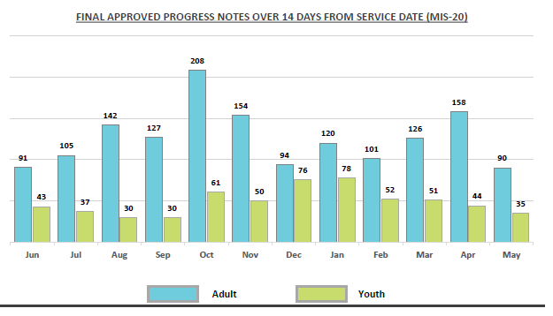
PROGRESS NOTE timeliness

Slide 43
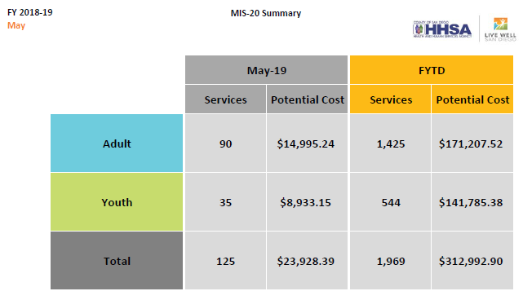
THE COST THAT WE CONTROL

Slide 44

SHOUT OUT TO PROGRAMS!
Overall Disallowance Rate by LE
under 5% benchmark
MRR Compliance by LE with
90% or higher score
SAY
Exodus
North County Lifeline
New Alternatives
Palomar Family Services
San Diego Unified
Family Health Centers
Fred Finch
YMCA
 | SAY
 | North County Lifeline
 | San Diego Unified
 | New Alternatives
 | Exodus
 | Deaf Community Services
 | Family Health Centers
 | County of San Diego
 | Survivors of Torture
 | San Diego Center for Children
 | YMCA

Slide 45
MRR Satisfaction results
The QM Specialist had a clear understanding of the types of services provided by my program(s). 4.43/5.0
QM Specialist reviewed the prior fiscal year’s MRR Summary results and the results of the current MRR in detail including compliance issues, trends, areas for improvement, areas of program strength, and I was able to ask questions for any items out of compliance. 4.56/5.0
QM Specialist was able to articulate the reason why an item was marked out of compliance. 4.57/5.0
I was able to discuss with the QM Specialist a difference of opinion for an item out of compliance and was satisfied with the resolution, even if I disagreed with the QM Specialist’s interpretation. 4.48/5.0
If I continued to disagree with the QM Specialist’s opinion for an out of compliance item, I was offered the ability to discuss the matter directly with the QM Specialist’s Supervisor. 4.25/5.0

Slide 46
MRR Satisfaction results
The QM Specialist was knowledgeable about Title 9 regulations and County documentation standards and was able to answer questions to my satisfaction. 4.45/5.0
The QM Specialist provided feedback to the Program about their Self Review and incorporated this information into the MRR. 4.3/5.0
When I received the written MRR results from the QM Specialist, the results were consistent with the feedback that I received during the exit interview. 4.35/5.0
The QM Specialist was professional, collaborative, and overall helpful during the MRR process. 4.61/5.0
Note: 23 responses received this FY compared to 16 responses last year.

Slide 47
MRR Process Fy 19-20
GOAL
  Collaborative approach (program self review)
  Increase knowledge of documentation standards
  Review of all direct service staff
  MRR Feedback using Survey Monkey
FOCUS – MEDICAL NECESSITY
  Assessment
  Client Plan
  Progress notes
  Billing

Slide 48
MRR Process Fy 19-20
  QM Specialist will contact PM with client names
  Programs will review only 5 charts out of total selected
  Complete review within two weeks (10 business days)
  Attestation by Legal Entity Executive staff
  Return MRR Program Self Review
  QM Specialist conduct MRR and exit interview
  Final MRR sent within 30 days
  Quality Improvement Plan (QIP) due within 14 days
  Follow up and ongoing monitoring

Slide 49
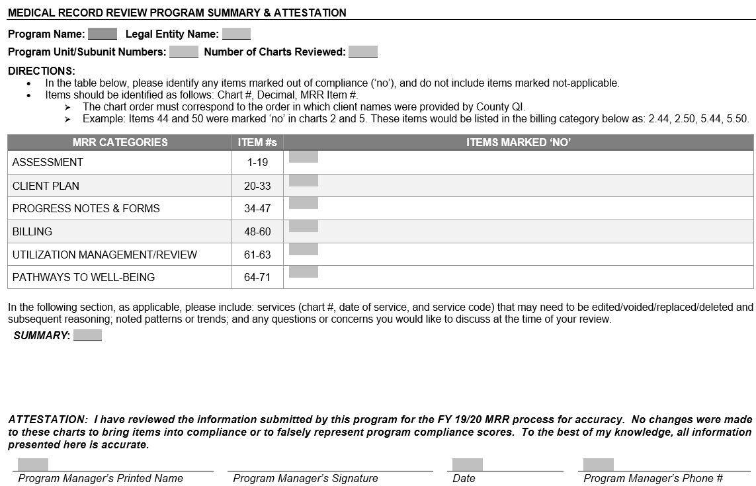
MRR Process Fy 19-20

Slide 50
MRR Process Fy 19-20
AFTER THE REVIEW
  Exit Interview
  Ask Questions – there should be no surprises
  Feedback Survey to QM
ISSUE RESOLUTION – Compliance Items
  QM Specialist
    QM Supervisor
      QM MHP Program Coordinator
APPEAL – Must include request on letterhead and evidence, site regulations, can’t be based on “feeling”
  Only recoupments/disallowances are subject to appeal
    Level One – QM MHP Program Coordinator
    Level Two – QI Unit Administrator

Slide 51
MRR Tool updates
3 | Initial BHA was completed in its entirety and final approved within 30 calendar days of program assignment (date of assignment counts as day one).
12 | In the BHA covering the review period, if any item on the PRA is marked "yes," the Overall Risk and Treatment Planning Section is completed. In addition, any “yes” answers to questions with an asterisk demonstrate documentation of review and creation of a safety plan with a clinical supervisor/designee.
13 | Within the past year (from date of current MRR), when a client has discharged from a 24 hour facility (Hospital, Crisis House) for DTS/DTO, a High Risk Assessment (HRA) is completed at next contact with client.
22 | For CYF programs only, Client Plan contains CANS Sharing Confirmation Page as indicated.
40 | For clients discharged from an inpatient/crisis residential facility, documentation evidences client was assessed in a timely manner, and if urgent service needed, client was seen by a mental health professional within 48 business hours, or documented why not.
46 | For clients prescribed controlled substances, there is documentation that the CURES database is reviewed upon initial prescription and at least once every 4 months thereafter if the substance remains part of the treatment plan.
47 | Survey Question Only: The Youth Transition Self-Evaluation (YTSE) form had been completed for CYF clients 16 years or older within 30 days of assignment, updated at age 17, 17 ½, 18 and annually thereafter.
63 | For CYF programs only. Any CANS outcome with a Need rating of "2 or 3" has supporting indicators referencing the BHA.
65 | Progress Report to Child Welfare Services form is completed and updated within appropriate timelines and form indicates that CANS were shared with CWS, or reason documented why not.
69 | Documentation supports that a CFT (Child Family Team) meeting has occurred within 30 days of identification of Subclass on the Eligibility for PWB and Enhanced Services form, and at a minimum of every 90 days thereafter. If CFT meeting timelines are not met, documentation includes a justifiable reason for CFT meeting postponement and efforts to reschedule CFT meeting as soon as possible.
70 | Survey Question Only: During the review period, if a CFT meeting occurred, there is evidence in the hybrid chart that a CFT Referral form was completed and sent. If CFT Referral form was completed by an outside agency, there is evidence of this in the hybrid chart or documentation why not filed in chart.
Notes:
Questions 3 & 13 only had a few words added for clarity.
Question 12 addresses the new PRA requirement.
Question 22 addresses that the CANS was shared with the family, while questions 65 addresses that the CANS was shared with either CWS or Probation.
Question 46 was a survey question last FY, but now it is included in the overall compliance score.
Question 63 addresses the BHA and that it includes detailed documentation relating to any CANS Need rating of 2 or 3.
Question 69 was previously two separate question lasts FY. It is now combined and updated to indicated the documentation for missing the CFT meeting timelines must be justifiable.
Justifiable reasons include - youth or caregiver are unable to attend due to hospitalization, incarceration, or youth AWOL.
**With COR exception the following reasons are justifiable**
Referral sent to CFT Facilitation Program in a timely manner, but meeting was still unable to be scheduled within appropriate timelines.
Coordinating CFT meeting with other CWS meeting timeline, in order to limit impact on family.

Slide 52
Quality improvement plan
(qiP)
Required if compliance is less than 90% or disallowance rate greater than 5% (QM has discretion to ask for a QIP for specific issues)
QIP due within 14 days of receipt of final report
Respond specifically to deficiencies
  Trending issues
  Specific staff issues
  Billing and documentation issues
  Timeline issues
Create a specific monitoring plan – the how, when, where, who and mitigation plan
Submit evidence (Monitoring plan, training, sign-in sheets, etc.)

Slide 53
Quality improvement plan
(qiP)
Submit billing documentation to verify completed corrections (See Billing Summary)
Conditional QIP approval until all billing corrections are completed to final adjudication and sent to QM – program is responsible to follow up with QM.
How do you ensure the QIP is working?
Follow up to QM on QIP activities
Focus Reviews – revised process under review, update soon.

Slide 54
qm goals fy19-20
CLIENT PLAN COMPLIANCE WITH TIMELINES
  AT ADMISSION – WITHIN 30 DAYS
  ANNUAL OR UM
REDUCE DISALLOWANCE TO UNDER 5%
IMPROVE SYSTEM COMPLIANCE TO 90% PLUS
ZERO RECOUPMENTS – KEEP OUR FUNDING
  DUE TO PAST 14 DAYS DOCUMENTATION
  ZERO RECOUPMENTS FOR NO VALID CP

Slide 55
Client signatures
CP REQUIREMENTS:
CLIENT/LEGAL REP SIGNATURE AND DATE (if not available, go to #2)
DOCUMENTATION OF PARTICIPATION AND AGREEMENT
Documentation of participation in and agreement with the client plan may include reference in the client plan OR
A description in the medical record (e.g., in a progress note) of the beneficiary’s participation and agreement with the client plan.
The following is an example of a note that would meet the requirement:
Client participated in treatment planning meetings on (date) and (date). The client participated in developing their treatment plan goals; in particular, the goals for (state goal or goals that the beneficiary gave specific input for). The client was satisfied with the client plan and stated verbal agreement at the meeting held on (date).

Slide 56
QM Training FY17-18
TYPE | FY 18-19 OFFERED | FY 18-19 ATTENDED | FY 17-18 ATTENDED | FY 16-17 ATTENDED
A/OA OP DOC TRAINING | 4 | 136 | 113 | 148
CYF OP DOC TRAINING | 4 | 113 | 139 | 126
SUPPORT PARTNERS DOC TRAINING | 4 | 74 | 86 | 68
DOC PRACTICUM | 2 | 25 | NA | NA
ROOT CAUSE ANALYSIS TRAINING | 4 | 62 | 50 | 67
mHOMS DOC TRAINING | 4 | 79 | 0 | 127
ONSITE TRAININGS | 22 | 247 | 50 | 67
TOTAL | 40 | 736 | 388 | 586

Slide 57
ehr Training FY18-19
OPTUM TRAINING TEAM | CLASSES OFFERED | NUMBER ATTENDED
CCBH (Cerner) | 471 | 2260
Since October 2009 | 3,497 | 20,752

Slide 58
CLAIM IT ANYWAY
SUSPENSE CODES y and AQ

Slide 59
Suspense codes y and AQ are considered “Claim It Anyway” (CIA)
y Suspense - Service concurrent with an Admission Assignment
Indicates client is open to 24-hour program at same time as receiving outpatient treatment service.
Program must research and make corrections to the assignment or services as needed.
If assignments and services are correct, identify services on the report to be claimed with "CLAIM IT ANYWAY" and fax to QI Matters at Fax# 619-236-1953 for determination.
QI Matters will forward the approved report to MHBU for processing. Once processed, MHBU will fax the completed report to the program for continuation of internal process.
AQ Suspense - Service Diagnosis Not Supported
Program must research and make corrections to the Diagnosis Sheet for corresponding date of service. If unable to correct contact Optum help desk (800) 798-2254.

Slide 60
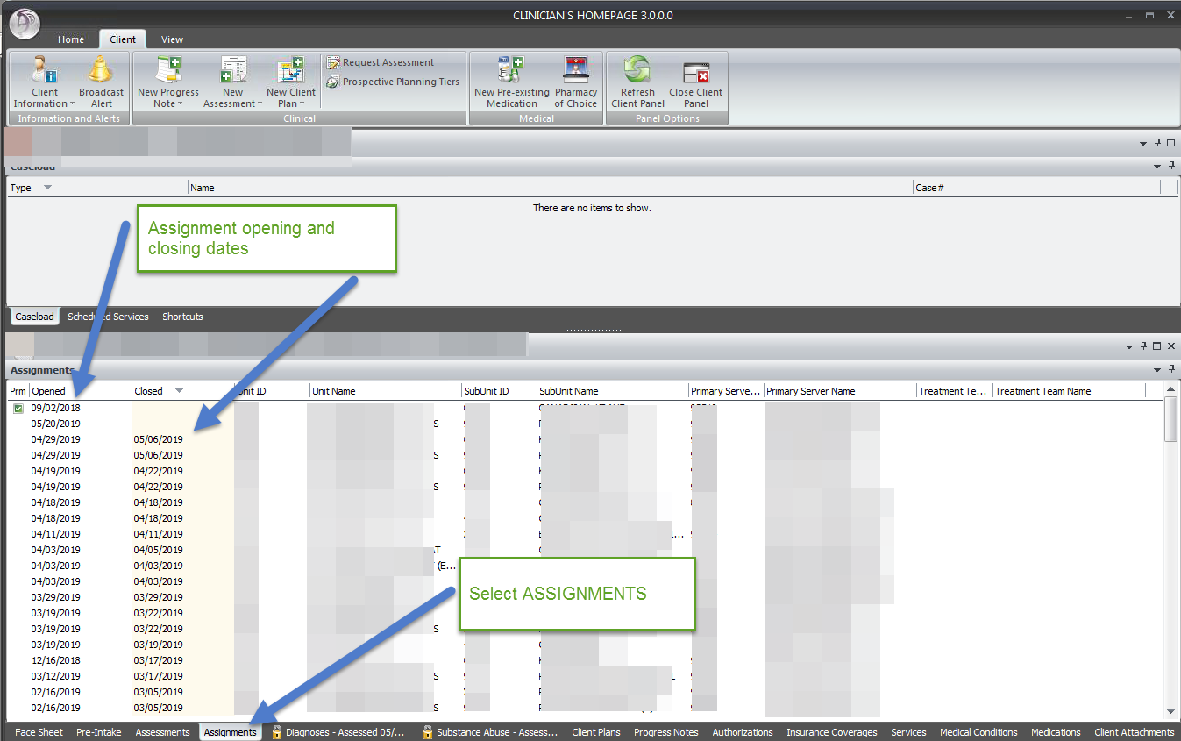
Y SUSPENSE
Check the date of the service that is in y suspense and check the client assignments.
If the date of service is the same as the day of admission or the day of discharge from the 24 hour facility – it CAN BE CLAIMED ANYWAY
If the service falls in between the day of admission and day of discharge the program will correct the progress note entry’s place of service to the 24 hour facility the client is at.

Slide 61
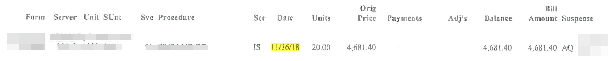
AQ Suspense Report
Suspense report with F29 written next to the AQ

Slide 62
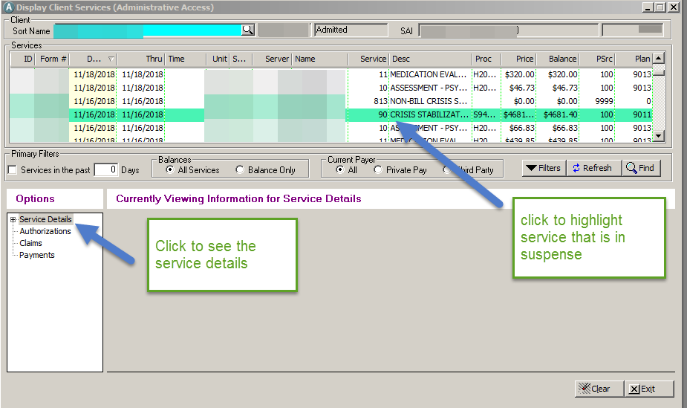
AQ Suspense
Display Client Services:
finding the Das

Slide 63
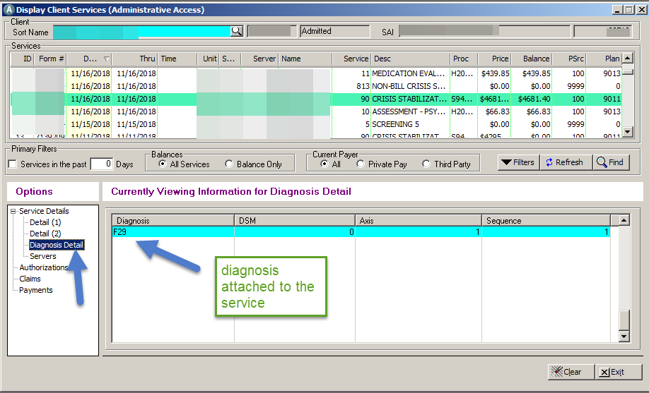
AQ Suspense
Display Client Services:
finding the Das

Slide 64
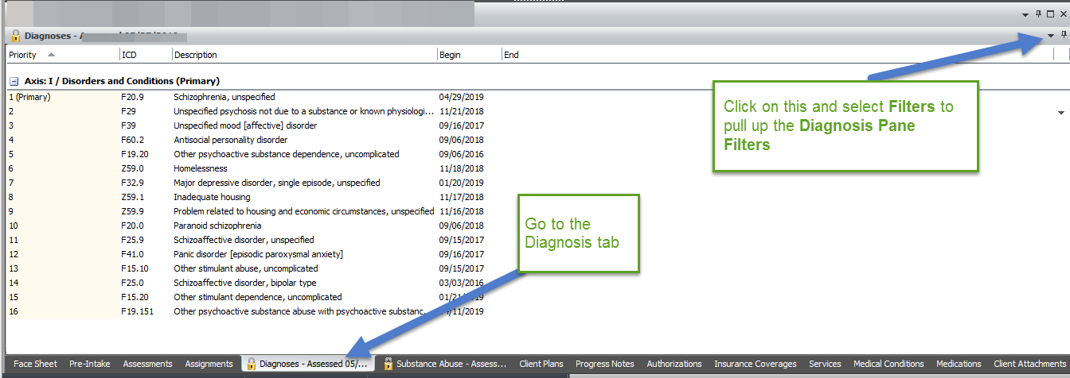
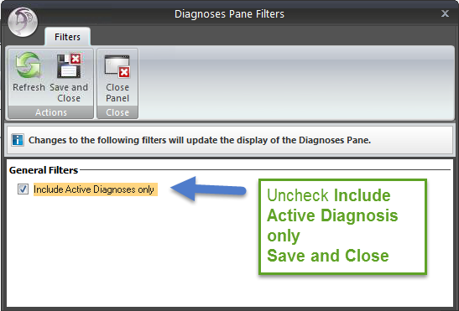
AQ Suspense – diagnosis tab
AQ Suspense – diagnosis tab

Slide 65
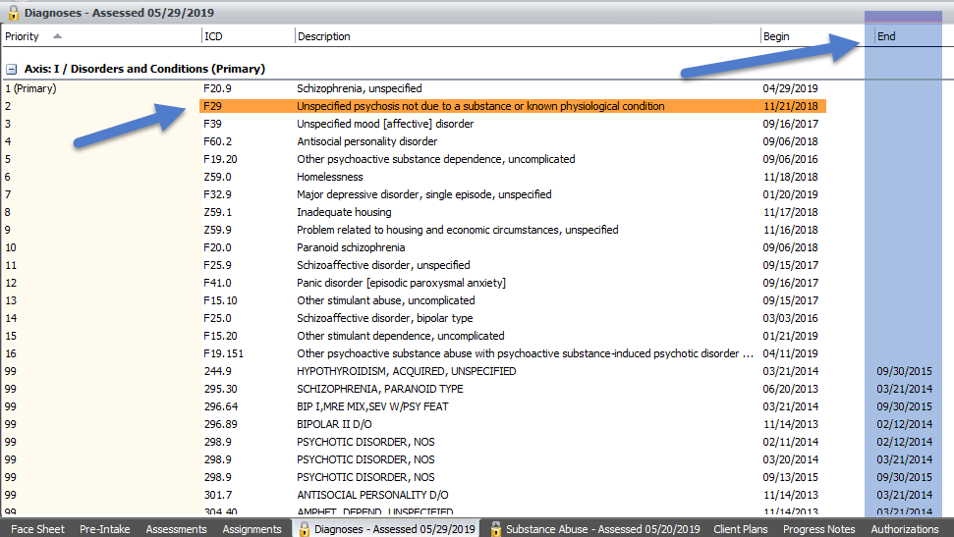
Diagnosis tab showing active
and ended diagnosis

Slide 66
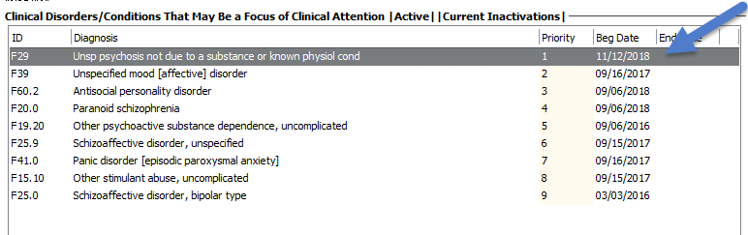
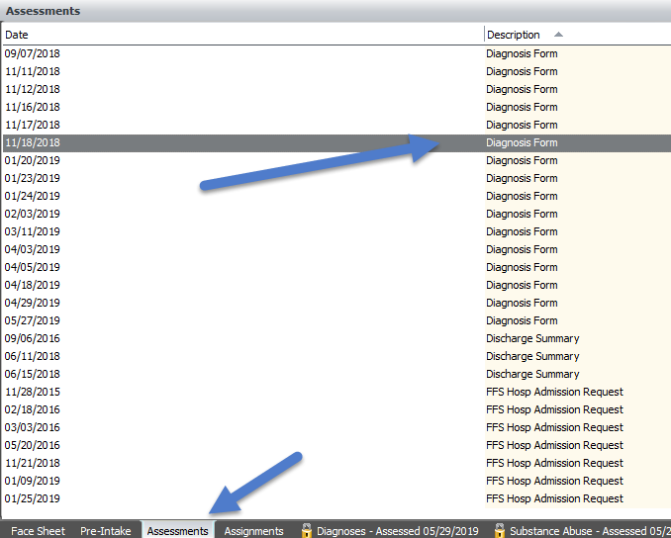
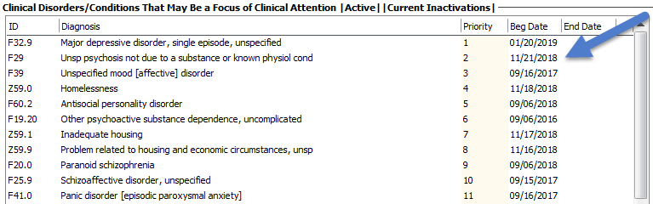
Diagnosis Form
11/12/18 Diagnosis Form
1/20/19 Diagnosis Form

Slide 67
DIAGNOSIS FORM REMINDERS
 | CLIENT IS ONLY ASSIGNED/OPEN TO YOUR PROGRAM | CLIENT IS OPEN TO OTHER PROGRAM(S) AND YOURS
End a diagnosis that is not being used by your program. | YES (Do not backdate the end date) | NO! Consult with the other program(s) prior to making any changes to the diagnoses.
Restart a diagnosis that is already active. | NEVER! | NEVER!

Slide 68
Continuity of care
Effective July 1, 2018, Title 42 of the Code of Federal Regulations, part 438.62 requires the State to have in effect a transition of care policy to ensure continued access to services during a beneficiary’s transition from Medi-Cal fee-for-service (FFS) to a managed care program or transition from one managed care entity to another, when the beneficiary, in the absence of continued services, would suffer serious detriment to their health or be at risk of hospitalization or institutionalization.

Slide 69
Continuity of care
All beneficiaries have the right to request continuity of care – 30 days timelines
Service may be provided for a period not to exceed 12 months
This policy applies under these conditions:
  The provider has voluntarily terminated employment or the contract with the MHP;
  The provider’s employment or contract has been terminated, for a reason other than issues related to quality of care or eligibility of the provider to participate in the Medi-Cal program;
  Transitioning from one county MHP to another county MHP due to a change in the beneficiary’s county of residence;
  Transitioning from an MCP to an MHP; or,
  Transitioning from Medi-Cal FFS to the MHP.
OPTUM is the point of contact for all continuity of care requests
Programs are expected to assist clients and collaborate with OPTUM to ensure a smooth and seamless experience

Slide 70
AUTHORIZATION OF SPECIALTY MENTAL HEALTH SERVICES
Department of Health Care Services (DHCS) issued IN 19-026 to ensure county Mental Health Plans (MHPs) comply with federal requirements for the authorization of specialty mental health services (SMHS).
  Require initial authorization and concurrent review for ongoing services:
    Inpatient (existing requirement)
    Crisis Residential Treatment Services (CRTS)
    Adult Residential Treatment Services (ARTS)
  Require prior authorization and concurrent review for ongoing services:
    Therapeutic Behavioral Services (TBS)
    Day Treatment Intensive
    Day Rehab
    Therapeutic Foster Care (TFC)
    Intensive Home-Based Services (IHBS)

Slide 71
AUTHORIZATION OF SPECIALTY MENTAL HEALTH SERVICES - CRTS
CRTS and ARTS are now required to have initial authorization and concurrent review by the MHP to ensure continued services meet medical necessity.
  CRTS
    Optum’s provider line will be the initial point of contact for authorization
    START referral form will be submitted to Optum for review to determine initial authorization.
      Authorization requests will receive an authorization decision within one hour.
    Utilization Review Committee (URC) meeting notes shall be submitted to Optum for concurrent reviews to request continued stay.

Slide 72
AUTHORIZATION OF SPECIALTY MENTAL HEALTH SERVICES - ARTS
  ARTS
    Residential authorization request will be submitted to Optum for review
    Authorization requests will be reviewed within 5 business days of receipt.
      Expedited authorizations will be reviewed no later than 72 hours of receipt.
    Authorization request for concurrent review shall be submitted on a quarterly basis.
      Clinical documentation that shows client’s progress and supports continued medical necessity will be accepted for authorization request. Clinical documentation may include:
        Client’s current status, progress towards treatment goals, continuing treatment plan, anticipated discharge plan, and barriers to discharge or treatment.
    A resident may return to the program within the seven-day bed hold period without Optum authorization (as long as the client was never formally discharged from the program).

Slide 73
AUTHORIZATION OF SPECIALTY MENTAL HEALTH SERVICES - TBS
TBS are now required to have prior authorization and concurrent review by the MHP to ensure continued medical necessity.
  Authorization requests shall be submitted to Optum.
    Authorization requests will be reviewed within 5 business days of receipt.
  Authorization requests shall be submitted to Optum for concurrent reviews to request continued services

Slide 74
AUTHORIZATION OF SPECIALTY MENTAL HEALTH SERVICES – Day Tx
Day Treatment Intensive and Day Rehab services will now require prior authorization and concurrent review by the MHP to ensure continued medical necessity.
  Previously, the ISR was sent to Optum within 3 days of the start of services. However, this is no longer applicable with new process.
  Preauthorization is required PRIOR to the provision of services.
    Retrospective authorizations are limited to the following circumstances:
      Retroactive Medi-Cal eligibility determinations
      Inaccuracies in the Medi-Cal Eligibility Data System;
      Authorization of services for beneficiaries with other health care coverage pending evidence of billing, including dual-eligible beneficiaries; and/or
      Beneficiary’s failure to identify payer

Slide 75
AUTHORIZATION OF SPECIALTY
MENTAL HEALTH SERVICES – TFC & IHBS
Therapeutic Foster Care and Intensive home based services
TFC and IHBS are now required to have prior authorization, by the MHP, and concurrent review of a beneficiary’s services to ensure continued medical necessity.
  The authorization process for TFC and IHBS is still being developed.

Slide 76
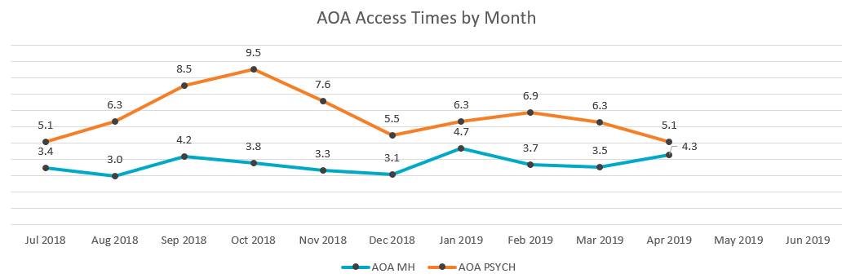
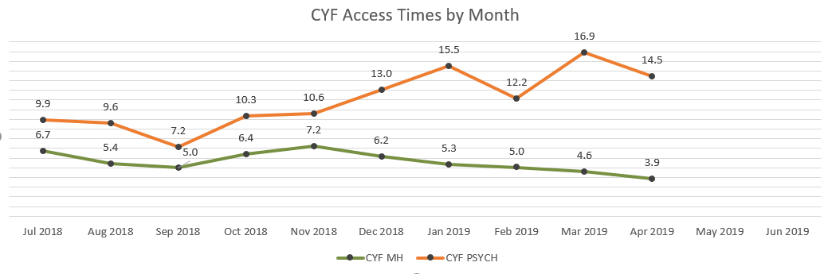
Access times – fy18-19

Slide 77
MEDICATION MONITORING (3 Qtrs.)
 | CYF | A/OA | TOTAL
Programs Reporting | 66 | 49 | 115
Charts with Meds | 3,639 | 24,815 | 28,454
Charts Reviewed | 197 (5%) | 416 (2%) | 613 (2%)
# Variances & % of possible variances in reviewed charts | 54 (1%) | 139 (2%) | 194 (1%)
Majority of Variances:
  Labs
  Informed Consent completion
  Number of each chemical class concurrently without a
  clearly documented rationale
Med Monitoring practices will be reviewed onsite by the QM Specialist during the Medical Record Review process.

Slide 78
Beneficiary rights: grievances
Focus for Improvement
Staff Behavior, Treatment Issues, Medication, Patients’ Rights
There were 4 Appeals for FY18 -19

Slide 79
FY18-19 SERIOUS INCIDENTs
(as of 5/31/19)
Death Under Questionable
Alleged Homicide Committed
by a Client
Confirmed Inappropriate
Staff Behavior
Injurious Assault by a Client
Apparent Overdose of
Tarasoff (Report made by
Serious Physical Injury
Physical Restraints (Prone or
Incident in Media
Homicide Attempt by a Client
Tarasoff (Report received by
Alcohol/Drugs
Death by Suicide
Suicide Attempt
Supine)
Death by Homicide
Program)
Serious Allegations of or
Circumstances
Program)
Other
Totals
A/OA
13
24
11
1
51
1
0
2
34
5
3
7
19
0
14
185
CYF
6
1
0
0
16
2
1
0
10
0
0
0
3
97
8
144
TOTAL
19
25
11
1
66
3
1
2
44
5
3
7
22
97
19
329
SOC

Slide 80
Quick updates & reminders
When reporting Serious Incidents, report the program name, client name, CCBH ID, date of incident, specific details about incident.
NEW SIR Reporting - Must report all client deaths and programs must report to local Medi-Cal office; SIR form is being updated.
MRR Tool – Billing Summary split into two tabs, one for Recoupments and one for Corrections
Check out the latest webinar posted on Optum –
Workgroup to revamp the MRR process for FY 20-21

Slide 81
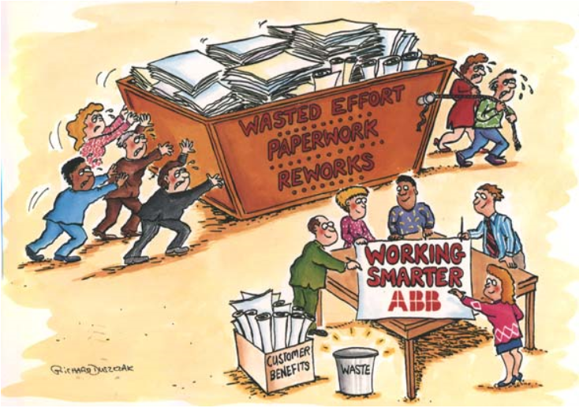
PROGRAM INTEGRITY
Training and regular monitoring activities are your best practices
BHS SOC

Slide 82
PROGRAM INTEGRITY
Fraud: an intentional act of deception, misrepresentation, or concealment in order to gain something of value
Waste: over-utilization of services (not caused by negligent actions) or the misuse of resources
Abuse: excessive or improper use of services or actions that is inconsistent with acceptable business or medical practices
Question: If you know the tools to use to prevent waste and abuse and you do not use them, who’s responsible? Are you making a good faith effort to minimize risk?

Slide 83
PROGRAM INTEGRITY
BILLING REVIEW REPORTS – daily/weekly
  Duplicate Services Report
  Billing Suspense Report
  Client Services Report
  Program Monitoring by Staff Report
  Non-final Approved Progress Notes

Slide 84
PROGRAM INTEGRITY
PROGRAM MONITORING – weekly/monthly
  Timeliness of Service Entry
  Service Exception Report
  No Show Summary Report
  Client Diagnosis Report
  Assessments Not Final Approved
  Client Plans Not Final Approved

Slide 85




Performance Improvement Team
Performance improvement team
(PIT)
Notes:
Metrics: A method of measuring something, or the results obtained from this.

Slide 86


PIT Hot Topics
QI Workplan Evaluation
Cultural Competency
Performance Improvement Projects

Slide 87


QI Workplan
QIWP Target Area: Services Are Client Centered
QIWP Target Area: Services Are Safe
QIWP Target Area: Services Are Effective
QIWP Target Area: Services Are Efficient and Accessible
QIWP Target Area: Services Are Timely

Slide 88
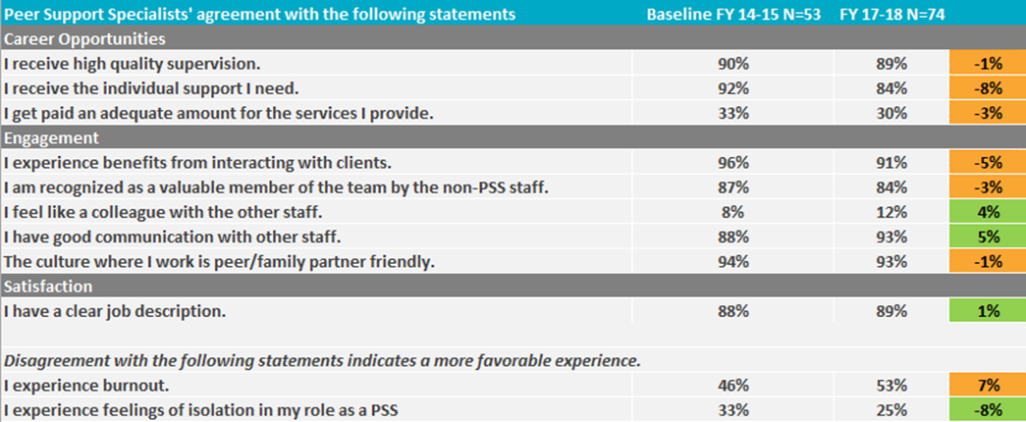
QI Workplan
Evaluate changes from FY 2014-15 baseline in satisfaction, engagement, and career opportunities among Support Specialists in the BHS system.

Slide 89
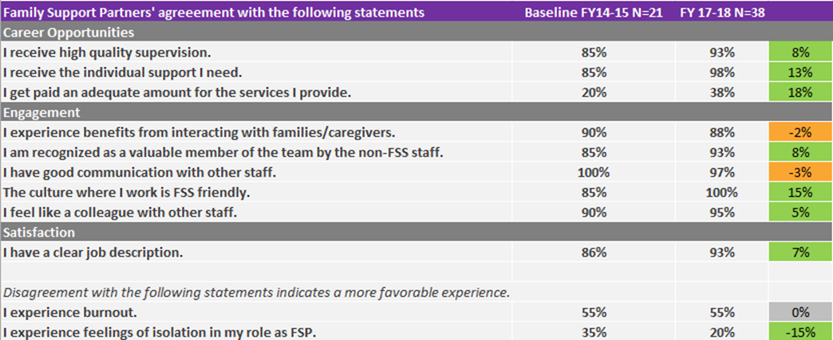
QI Workplan

Slide 90
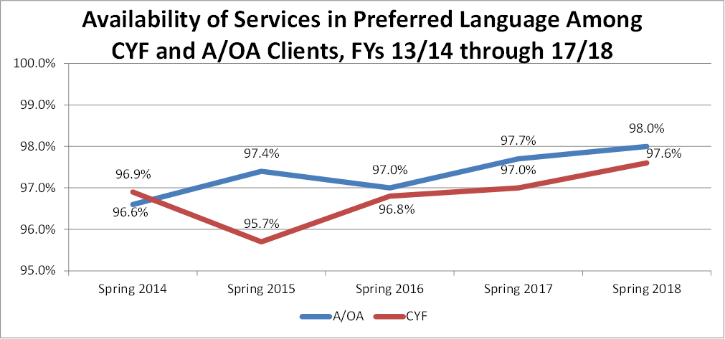
QI Workplan
100% of clients and families indicating in the State-required Consumer Perception Surveys that they had access to written info in their primary language and/or received services in the language they prefer (question specifically asks
“Were the services you received provided in the language you prefer?”).

Slide 91
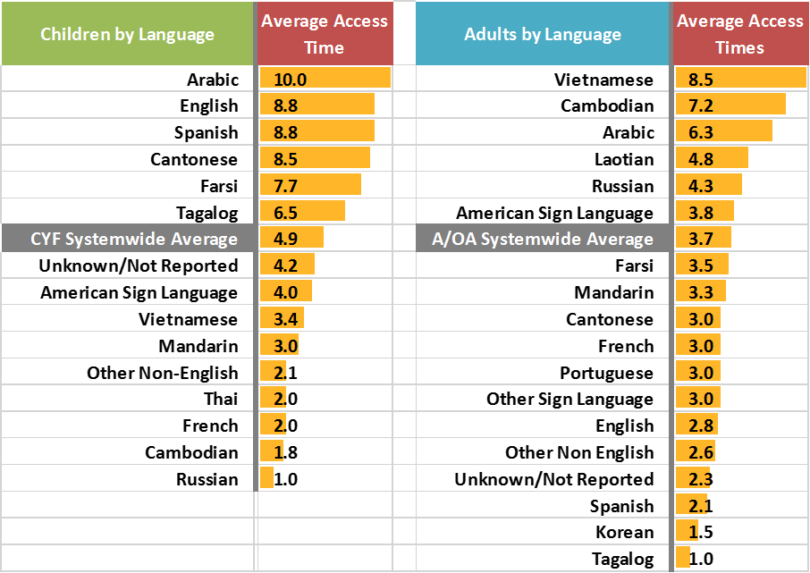
QI Workplan
100% of requests in all preferred languages meet the systemwide access time standard of within 10 business days for both CYF and A/OA clients.
Average Access Times for Specialty Mental Health Services by Language
Notes:
FY 2017-18 Access Times to Mental Health Assessments in the CYF System of Care Related to Language
The average systemwide access time to mental health assessments among CYF clients was 5.4 days.
The longest average CYF access time was for the Arabic language.
For the majority of CYF inquiries, English was the Preferred Service Language (73%), followed by Spanish (25%), and Arabic (1%). The rest of the languages each had less than 1% of the total inquiries.
FY 2017-18 Access Times to Mental Health Assessments in the A/OA System of Care Related to Language
The average systemwide access time to mental health assessments among A/OA clients was 3.7 days.
The longest average A/OA access time was for the Vietnamese language.
For the majority of the 4,778 A/OA inquiries, English was the Preferred Service Language (90%), followed by Spanish (4%), Arabic (2%), American Sign Language (1%), and Vietnamese (1%). The rest of the languages each had less than 1% of the inquiries.

Slide 92
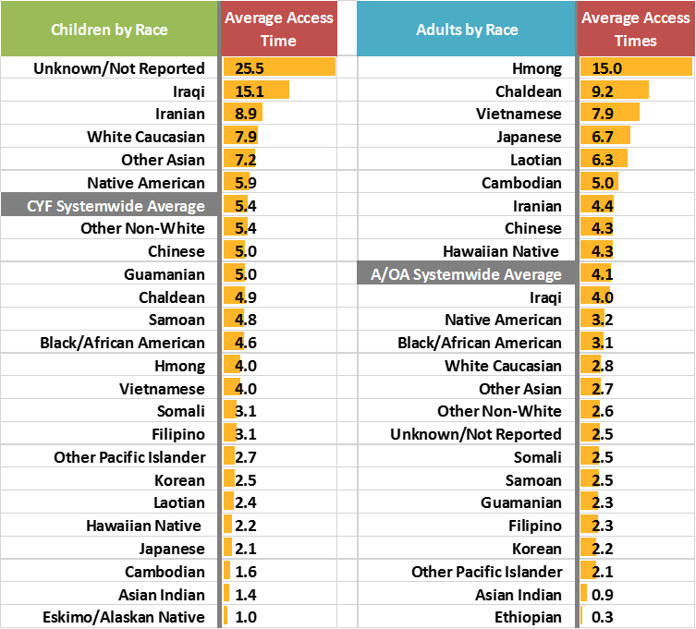
QI Workplan
100% of requests from all races/ethnicities meet the systemwide access time standard
of 10 days for both CYF and A/OA clients.
Average Access Times for Specialty Mental Health Services by Race/Ethnicity
Notes:
FY 2017-18 Access Times to Mental Health Assessments in the CYF System of Care Related to Race/Ethnicity
The average systemwide access time to mental health assessments among CYF clients was 5.4 days.
The CYF clients who waited longer than the systemwide average for a mental health assessment were of an unknown/not reported race, Iraqi, White Caucasian, Other Asian, or Native American.
FY 2017-18 Access Times to Mental Health Assessments in the A/OA System of Care Related to Race/Ethnicity
The average systemwide access time to mental health assessments among A/OA clients was 4.1 days.
The A/OA clients who waited longer than the systemwide average for a mental health assessment were Hmong, Chaldean, Vietnamese, Japanese, Laotian, Cambodian, Iranian, Chinese, or Hawaiian Native.

Slide 93

Cultural Competence
BHS identified and developed two assessment tools:
  Organizational Assessment: Cultural and Linguistic Competence Policy Assessment (CLCPA) – replaced the Culturally Competent Program Annual Self-Evaluation (CC-PAS)
      Next issued: February 2020
  Individual/Staff Assessment: Promoting Cultural Diversity Self-Assessment Checklist (PCDSA) – replaced the California Brief Multicultural Competence Scale (CBMCS)
      Next issued: October 2020

Slide 94
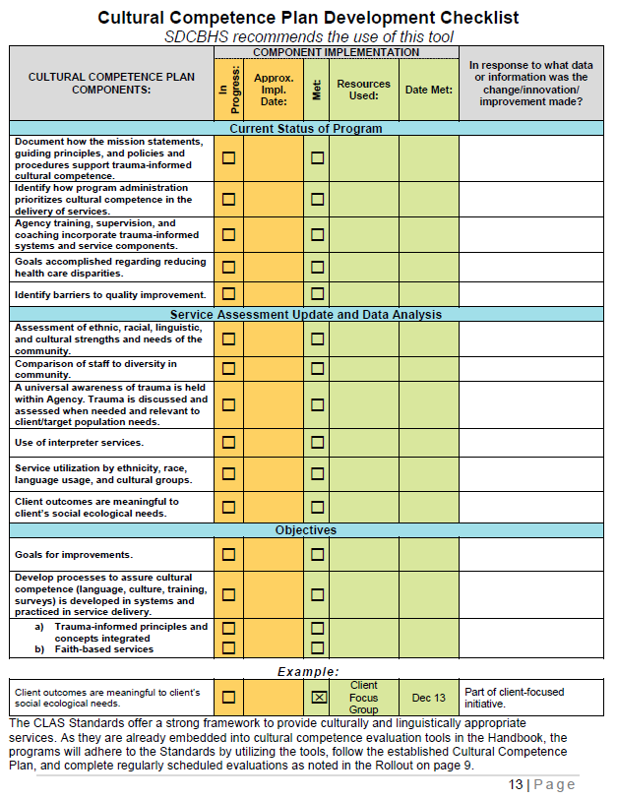
Cultural Competence
  Cultural Competence Plan
  How often do you update?
  How often do you review with staff?
  Checklist can be found on page 13 of the Cultural Competence Handbook. Located on the BHS TRL:
https://www.sandiegocounty.gov/content/dam/sdc/hhsa/programs/bhs/TRL/TRL%20Section%204/CulturalCompetenceHandbook_Final_11-20-17.pdf

Slide 95
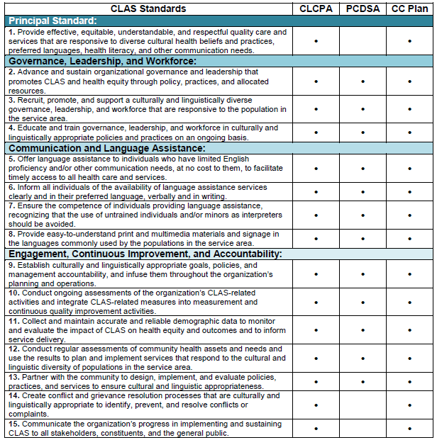

Cultural Competence
  The enhanced National Standards for Culturally and Linguistically Appropriate Services in Health and Health Care (CLAS Standards) were developed by the Health and Human Services Office of Minority Health and are intended to advance health equity, improve quality, and help eliminate health care disparities (see the Resources section). Implementing strategies to improve and ensure cultural and linguistic competency in the behavioral health care systems using the CLAS standards is a powerful way to address disparities and ensure all populations have equal access to services and supports. In addition to the new requirements in each programs’ Statements of Work for adhering to CLAS standards, the following chart shows how CLAS Standards are already embedded into cultural competence evaluation tools provided in the Handbook.
https://theacademy.sdsu.edu/programs/rihs/
Source: Think Cultural Health, Office of Minority Health, U.S. Department of Health and Human Services
For more information and to access CLAS standards visit www.thinkculturalhealth.hhs.gov/clas.

Slide 96
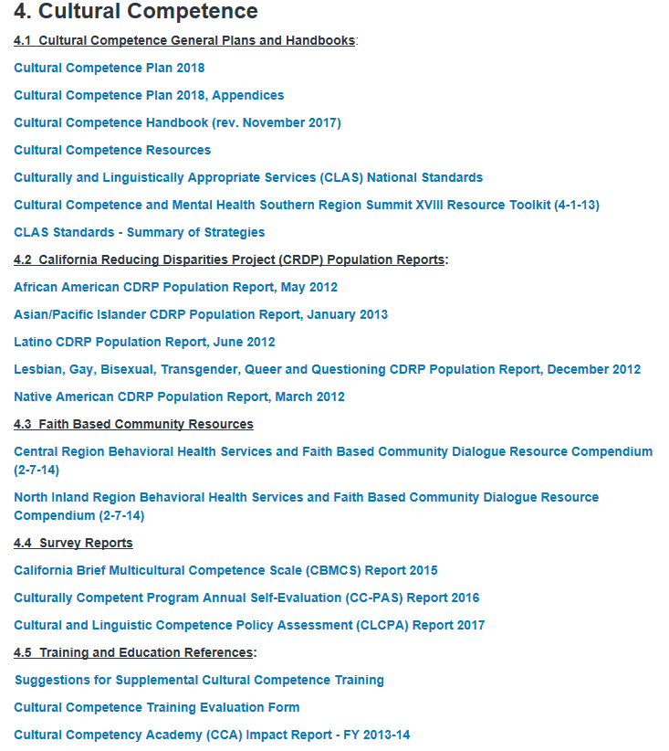

Cultural Competence
Resource:
  Technical Resource Library:
    https://www.sandiegocounty.gov/content/sdc/hhsa/programs/bhs/technical_resource_library.html

Slide 97
PIPs performance improvement projects
Non‐Clinical PIP: Discharge Summary Reasons
  1. Will focusing on reasons for outpatient clients not continuing services (discharge reason of “did not return”) and developing/implementing strategies improve long term client care?
Clinical PIP: Family Therapy
  1. Will providing training on caregiver engagement increase the number of family therapy sessions?
  2. Will providing training on caregiver engagement increase the quality of caregiver participation in family therapy sessions?

Slide 98

Questions?
For more information or reports, contact BHSQIPIT@sdcounty.ca.gov.
Liz Miles, Ed.D, MPH, MSW, Principal Administrative Analyst
QI Performance Improvement Team (PIT) Elizabeth.Miles@sdcounty.ca.gov

Slide 99


Management Information Systems
Notes:
Metrics: A method of measuring something, or the results obtained from this.

Slide 100
EPCS for CCBH
Electronic Prescribing of Controlled Substances (EPCS)

Slide 101
ELECTRONIC PRESCRIBING OF
CONTROLED SUBSTANCES
If prescribing at least 10 controlled substances per month
Prescriber using DHP
Apply through MIS

Slide 102
HOW IT’S USED
Contact MIS
Apply process explained
Prescriber given a token
Prescribe through DHP
SIMPLE!!

Slide 103
Need a Tutorial?
Access to Services journal
https://www.optumsandiego.com/content/sandiego/en/asj.html
Includes Tip Sheet

Slide 104
ASJ - Phase I
Clients with Medi-Cal
Assign a client number
Enter 1st Appointment Date
Enter 1st Treatment Date

Slide 105
Access to Services journal
Final Approve each time
Service Code for Assessment is 10 or 11
Use Service code 30 for Treatment
BE ACCURATE!

Slide 106
ASJ - Phase II - No Date Yet
Referral Source
Assessment Appt Second, Third Offer Date
Assessment Appt Accepted Date
Treatment Appt Second, Third Offer Date
Treatment Appt Accepted Date
Closure Reason
Referred To

Slide 107
OPTUM WEBSITE DEMONSTRATION
Presented by Michael Blanchard, LMFT, QM Specialist

Slide 108
QUESTIONS
QIMatters.HHSA@sdcounty.ca.gov

