Slide 1
Client Services Report- Pay Source 9999
County of San Diego

Slide 2
Whys? And Whats?
Who should run this report? –Every program.
When should it be run? –Its recommended that this report be run monthly towards the end of the month.
Why should I run this report? –This report informs you primarily of all the services that are staging to Pay Source 9999(Private Pay).
What do I do after I run it? – Check if those services staging to 9999 are staging correctly. If they are staging incorrectly, investigate where they should be staging and inform the MHBU.

Slide 3
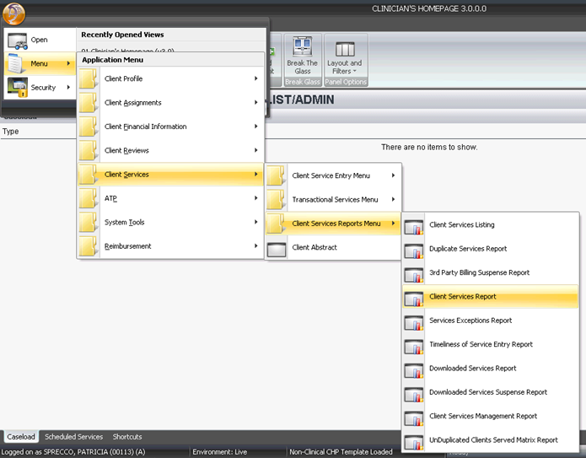
How do I run it?

Slide 4
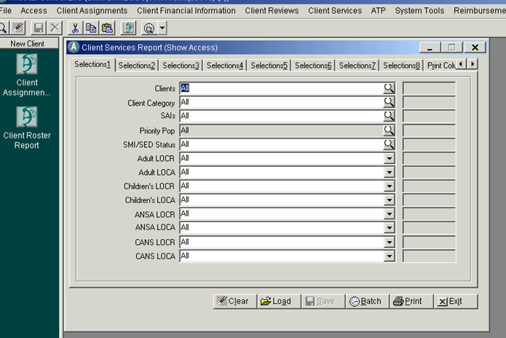
Loading the Pay Source 9999 Template
Click on Load to search for the report template.

Slide 5
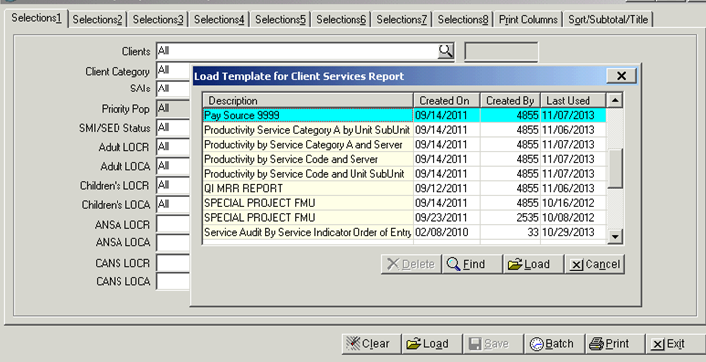
Loading the Pay Source 9999 Template cont’d
Choose the template and click on the Load button

Slide 6
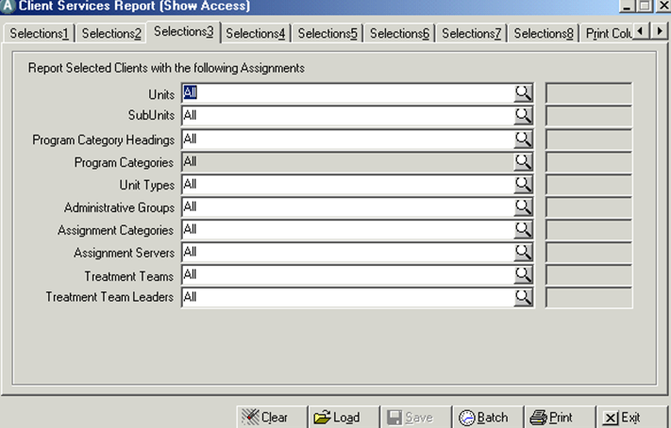
Start on Tab 3
Enter YOUR Unit and SubUnits

Slide 7
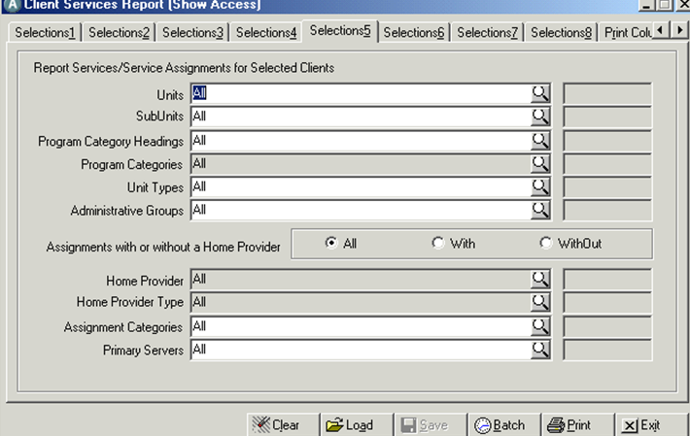
Go to Tab 5
Enter YOUR Unit and SubUnit again.

Slide 8
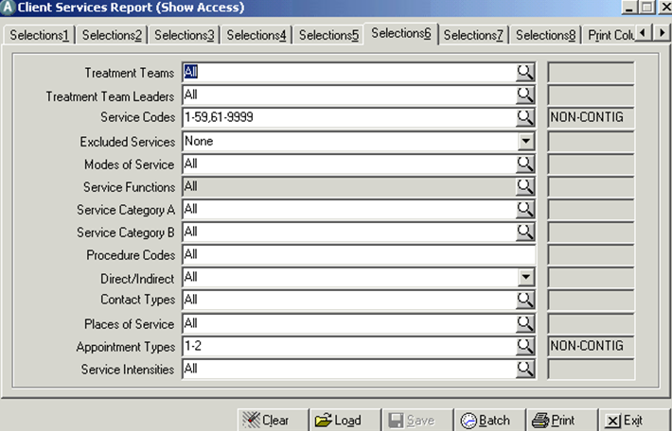
Tab 6. Leave as is

Slide 9
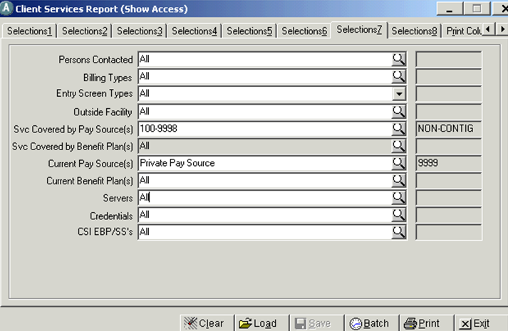
Tab 7
This field allows you to choose only services that should be staging to any pay source with in the range specified. (not Private Pay)
These field will be auto-populated for your convenience when the template is initially loaded. This field prompts the report to generate services currently staging to the pay source indicated.

Slide 10
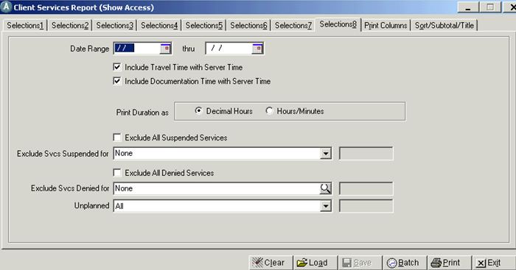
Tab 8
Enter your Service Date Range. Leave everything else as seen here.

Slide 11
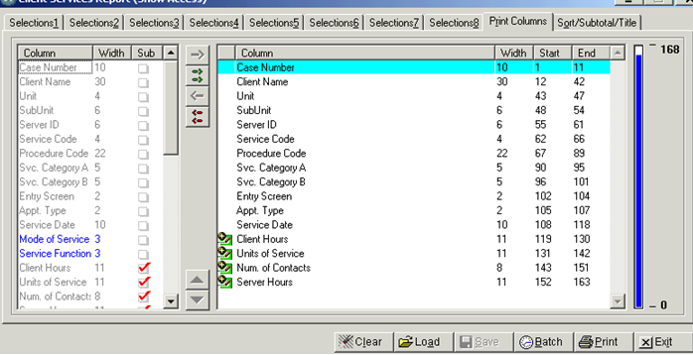
Print Columns
Here we are indicating that we want the report to include the following information, In that order from left to right.

Slide 12
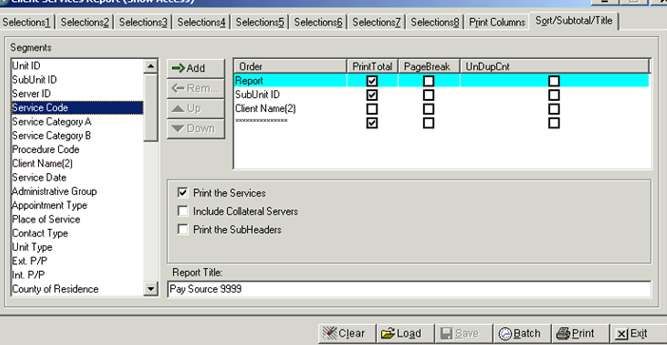
Sort/Subtotal/Title
You can choose to sort or name your report differently or otherwise just print.

Slide 13
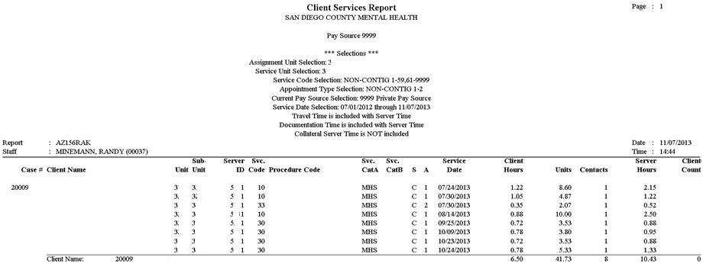
Pay Source 9999 report

Slide 14
Now what?
Determine if the services should be staging to a different pay source.
  If in fact there should be another pay source (i.e. Medi-Mal, Medicare, private insurance), check if it’s entered in the client’s 3rd party coverage's screen. If not, enter it (please make sure information is accurate)
  If it’s staging correctly, you might want to see if there is an UMDAP entered. Otherwise services will be billed to the client at full pay.
Try to determine what the error is and contact the MHBU for further assistance.
  Check if the 3rd Party Coverage's screen shows that the client has Insurance( Medi-Cal, Medicare, Private insurance).
  If there is a 3rd Party insurance, check the dates entered, or if it has been erroneously terminated.

Slide 15
Mental Health Billing Unit contact info.
Email: MHBillingUnit.HHSA@sdcounty.ca.gov
Phone: (619)-338-2612
Fax: (858)467-9682
Address: County of San Diego, MHBU
      P.O. Box 129153
      San Diego, CA 92112

